Slide 1
Understanding Modern Vulnerability Management
Jerry Gamblin, Principal Engineer, Cisco Threat Detection and Response
June 18th, 2024

Slide 2
About Me
Jerry Gamblin
Principal Security Engineer
Cisco Threat Detection & Response
Contact:
gamblin@cisco.com
@jgamblin
Jerrygamblin.com

Slide 3
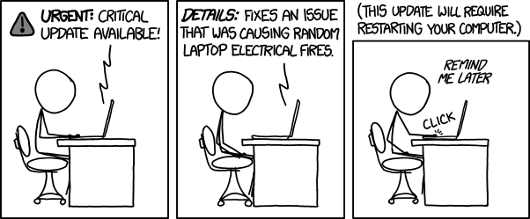

Slide 4
Agenda
The Evolving Cybersecurity Landscape
Identifying Vulnerabilities in the New Era
Prioritizing Risks and Threats
Mitigating and Managing Vulnerabilities
The Future of Vulnerability Management

Slide 5
The Evolving Cybersecurity Landscape

Slide 6
CVE Growth
Data From CVE.ICU

Slide 7
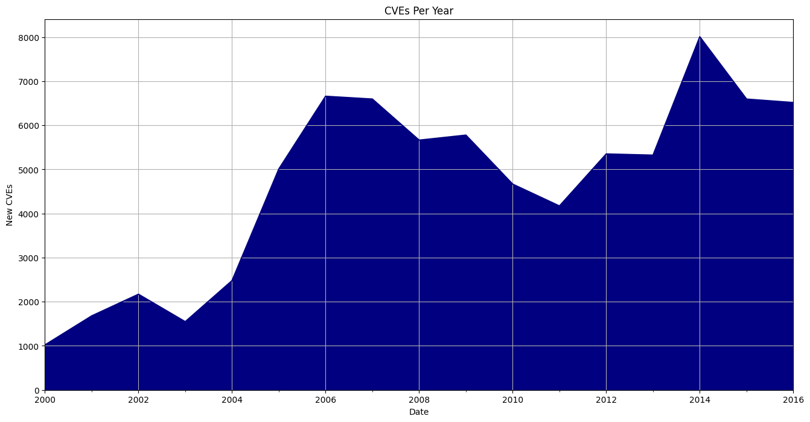
Data From CVE.ICU

Slide 8
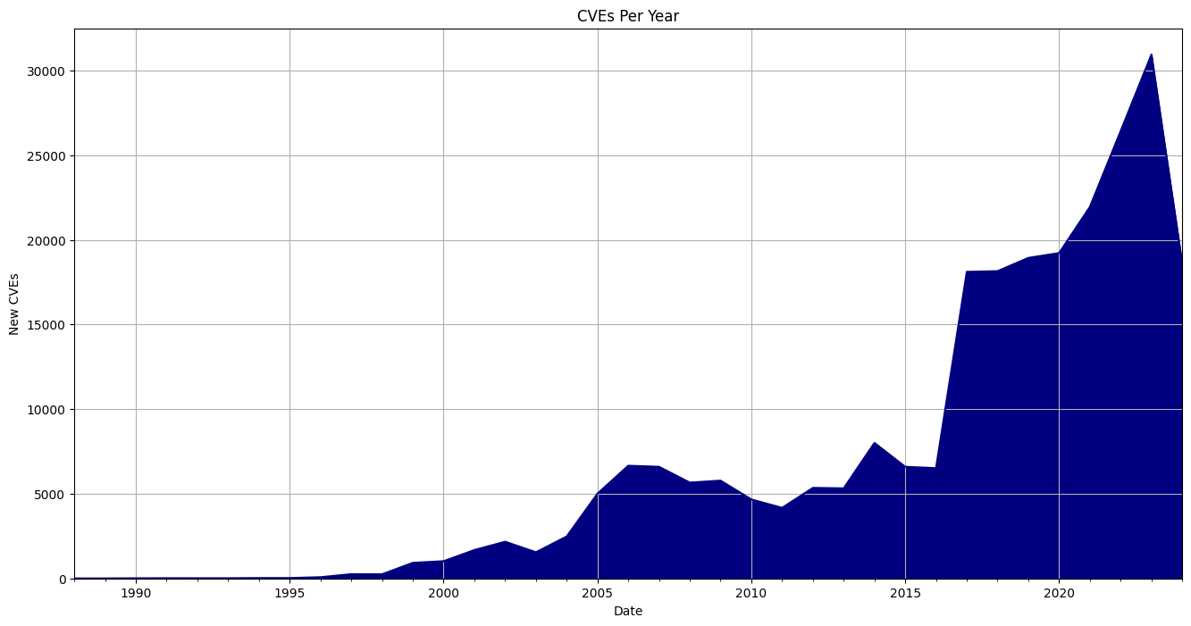
Data From CVE.ICU

Slide 9
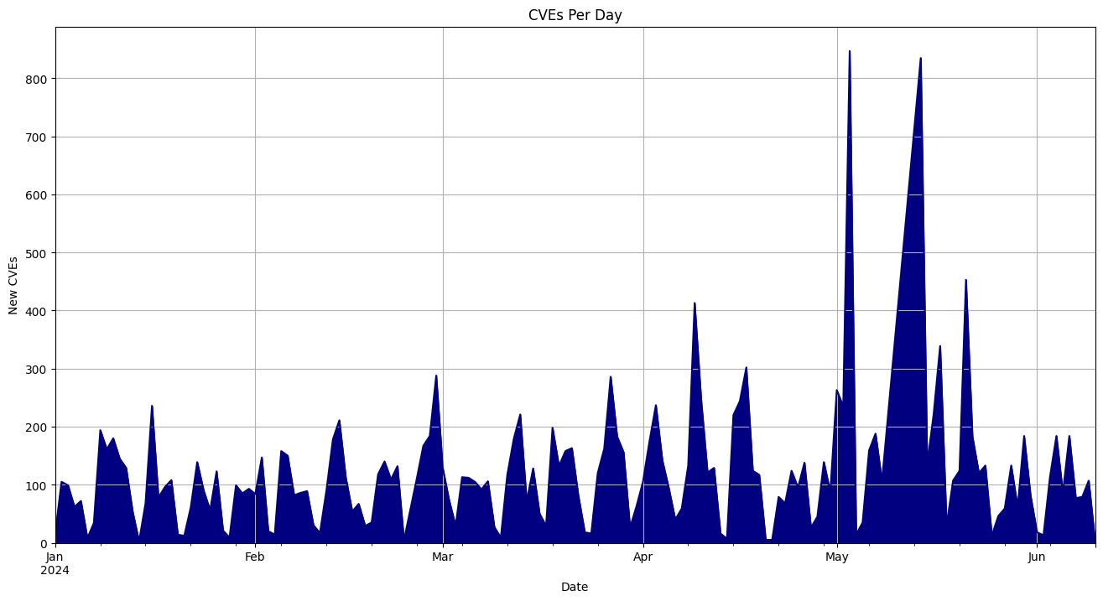
Data From CVE.ICU

Slide 10
Network Changes

Slide 11
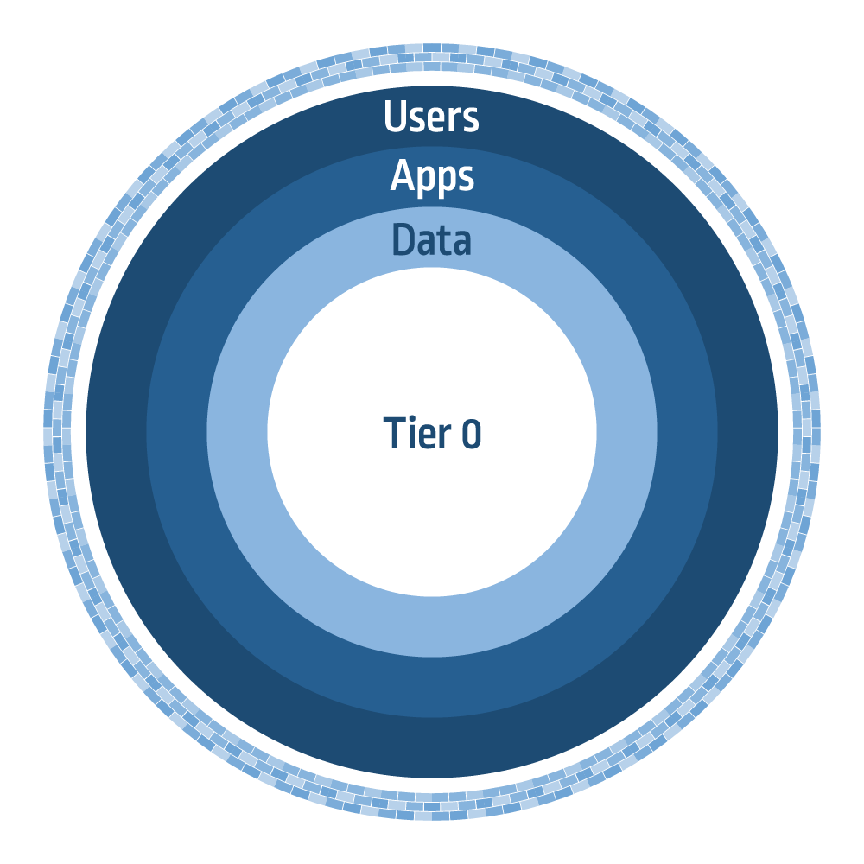

Slide 12
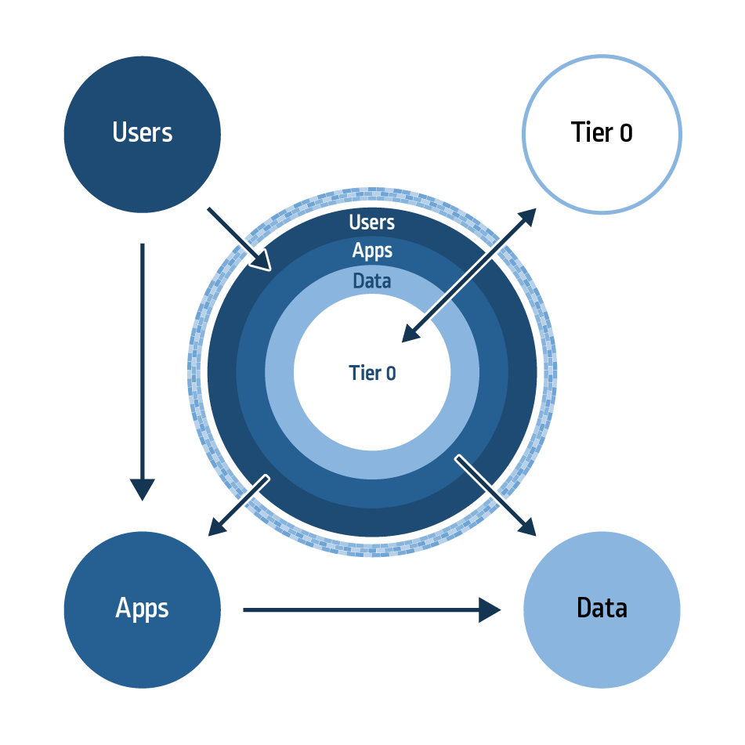

Slide 13
Identifying Vulnerabilities in the New Era

Slide 14
Most Common Vulnerability Types
Unpatched Software
Internal Software Flaws
Misconfigurations
Cloud
Software
Network

Slide 15
Over 75% of all data breaches do not use a known vulnerability with an assigned CVE.
Cyentia P2P Reports
https://www.cyentia.com/research/

Slide 16
Continuous Monitoring & Scanning

Slide 17
Insert Sales Pitch Here

Slide 18
The Use Of AI & ML

Slide 19
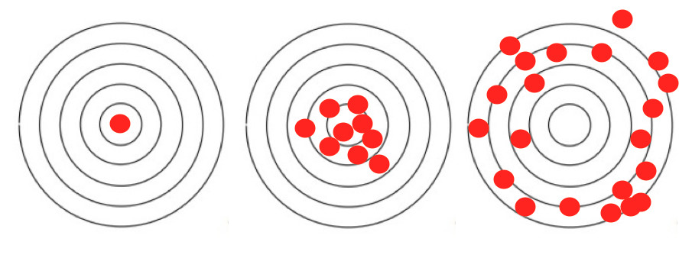
Detection Accuracy and Speed
Accuracy
Speed + Accuracy
Speed

Slide 20
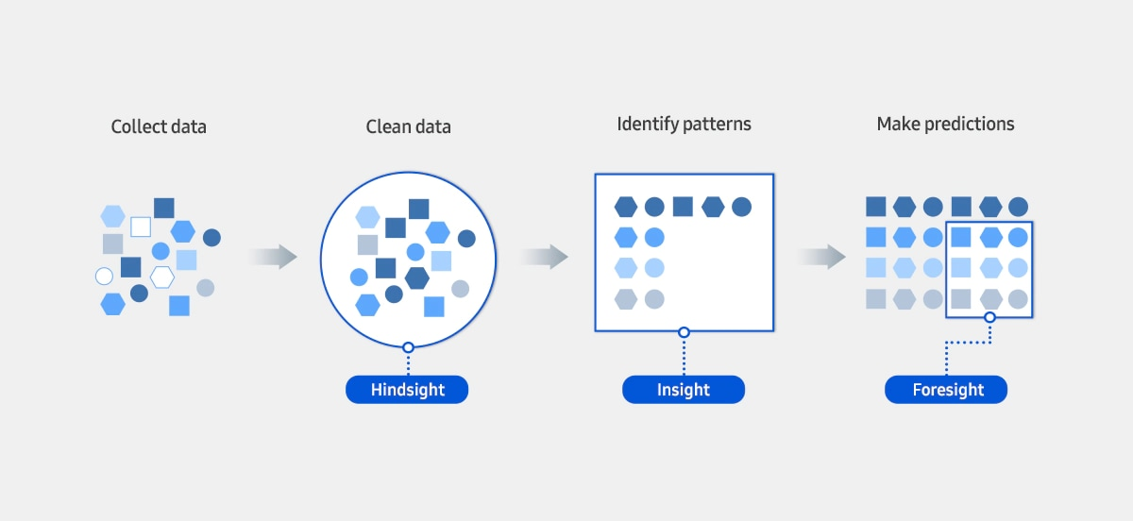
Predictive Analytics

Slide 21
Prioritizing Risks and Threats

Slide 22
CVE Scoring

Slide 23
7.11
CVSS
Average CVSS Score:
Data From CVE.ICU

Slide 24
Exploit Prediction Scoring System (EPSS)
Predictive Risk Scoring For All CVEs
Helps Actionable Prioritization
Open and Transparent Scoring
First.org/EPSS

Slide 25
Other Well Known Open-Source Risk Scoring
CISA Known Exploited Vulnerabilities Catalog
Rapid 7 Metasploit Modules
Project Discovery Nuclei Templates

Slide 26
Patchthis.app
List of 6,500 CVEs:
CISA Known Exploited Vulnerabilities Catalog
Rapid 7 Metasploit Modules
Project Discovery Nuclei Templates
EPSS > .95

Slide 27
Proprietary Risk Models
Cisco
Splunk
Tenable
Qualys
Wiz

Slide 28
Mitigating and Managing Vulnerabilities

Slide 29
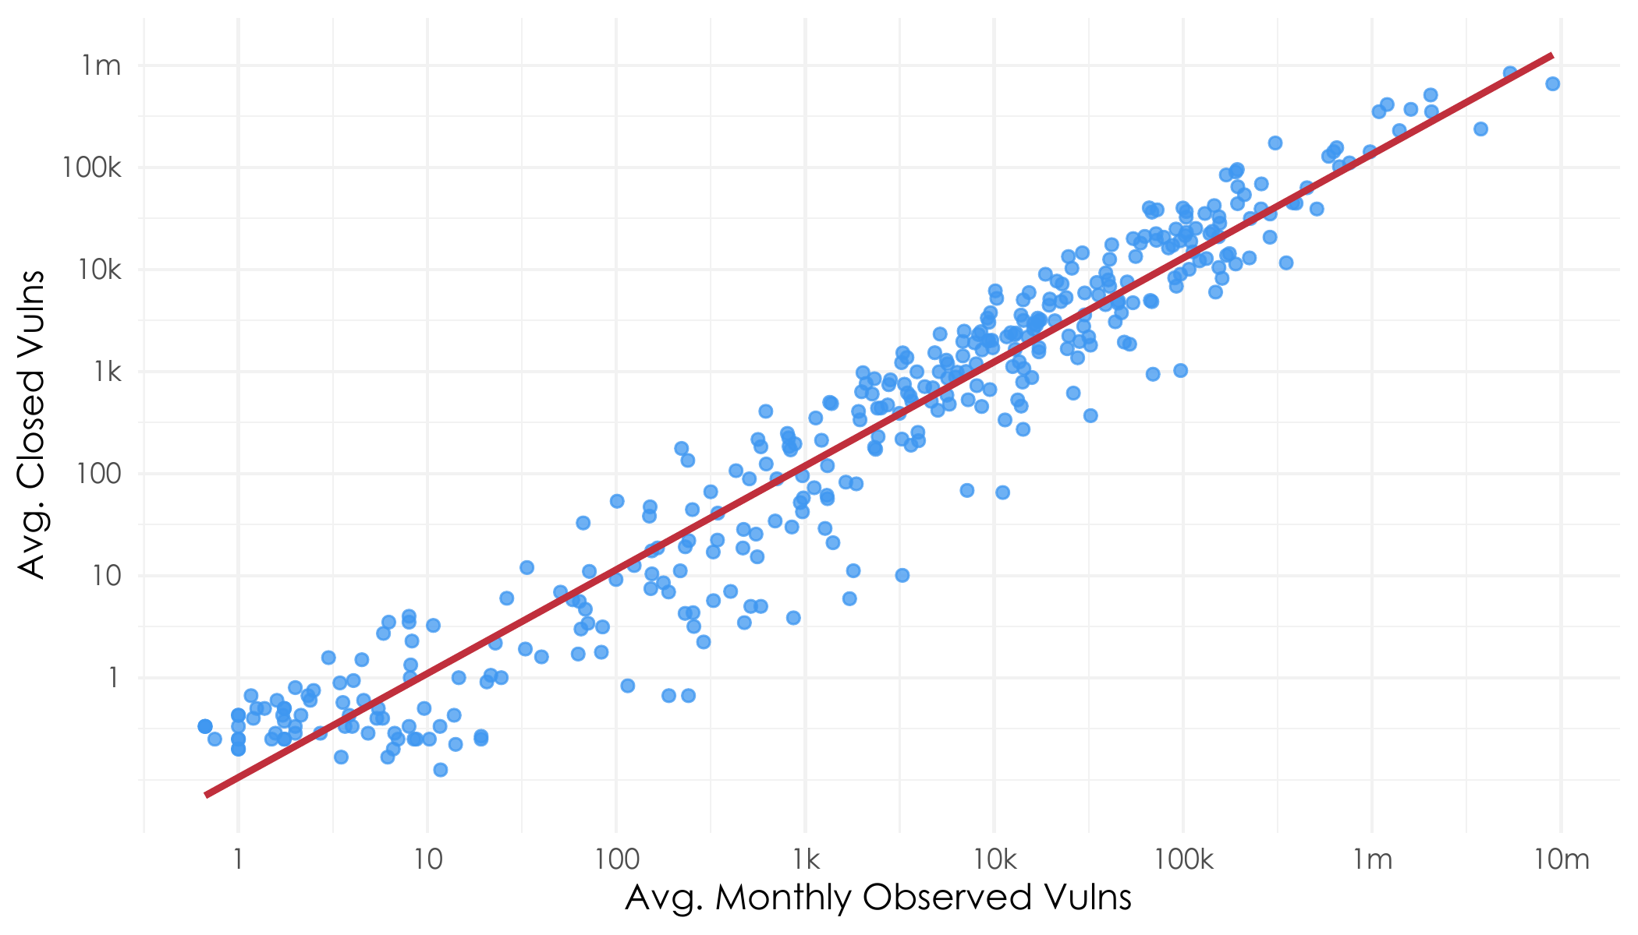
Remediation Capacity

Slide 30
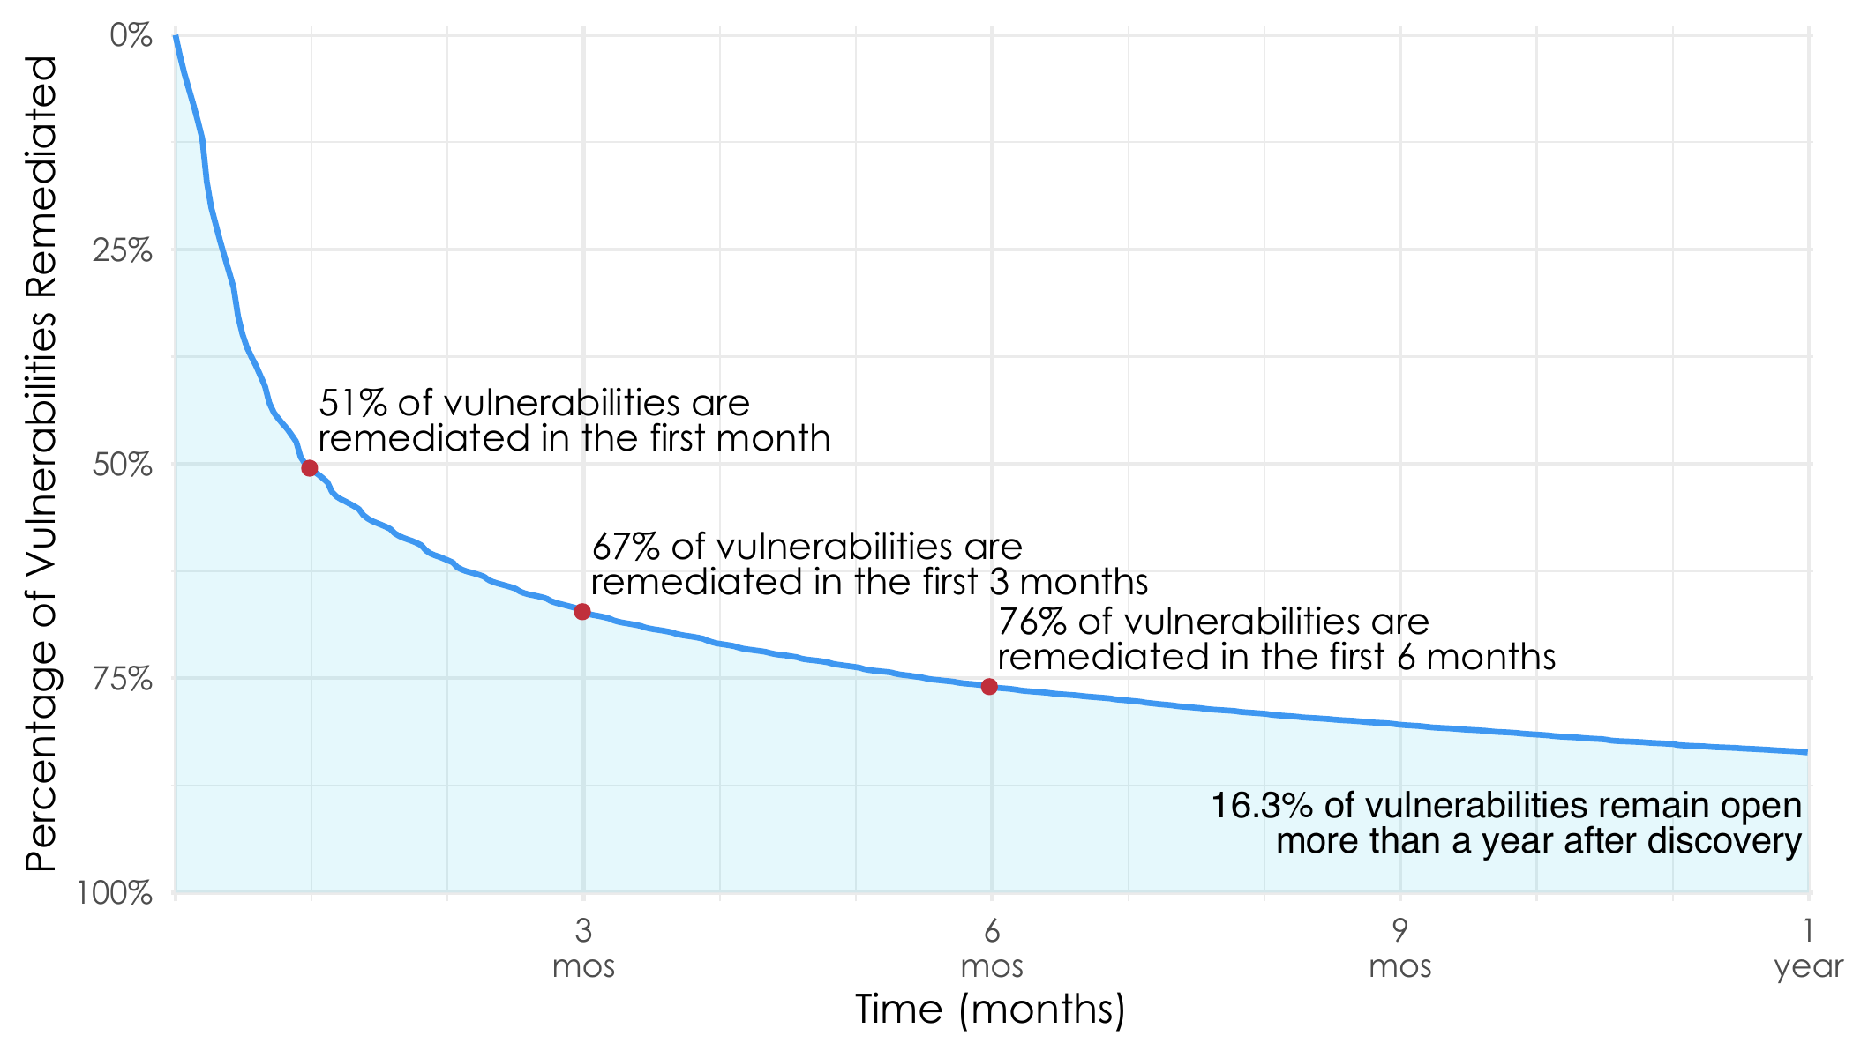
Average Remediation Velocity

Slide 31
The Future of Vulnerability Management

Slide 32
The Future of Vulnerability Management
Proactive.
Driven By Threat Intelligence.
It is Driven By Automation.
It Is Still Hard.

Slide 33
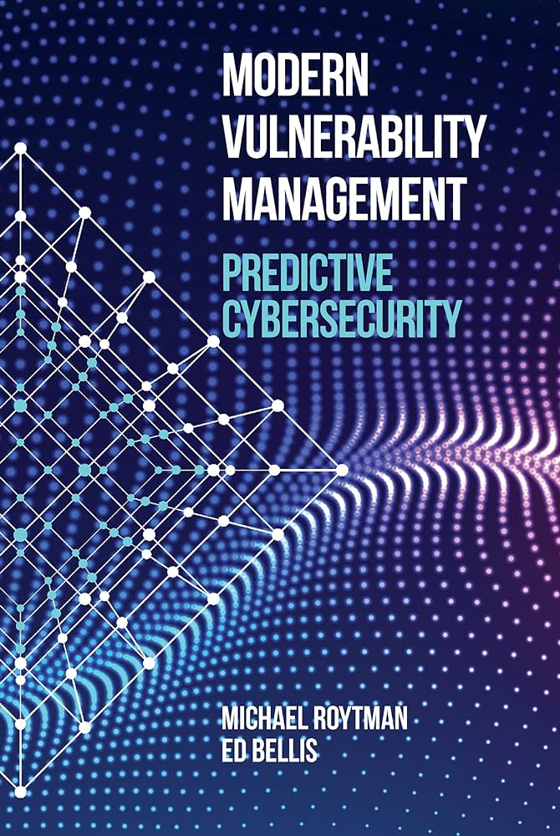
Want A Deeper Dive?

Slide 34
Contact Info
Jerry Gamblin
Principal Security Engineer
Cisco Threat Detection & Response
Contact:
gamblin@cisco.com
@jgamblin
Jerrygamblin.com

