Slide 1
ThinkShield Data Defense Power by Cigent
Matthew Frazier – Global VP of Sales

Slide 2
Summary of ThinkShield Data Defense
NEW
Only solution PROTECTS data when device is compromised
NEW
Solves the #1 endpoint security issue: ransomware
NEW
Extensive US Federal contracts securing most sensitive data
Data Defense
NEW
Cloud management of full-disk encryption (FDE)
NEW
Exclusive to Lenovo available on all commercial devices

Slide 3
The Endpoint Security Challenge
Detect and respond is insufficient!
Advanced threats
Ransomware
Data Theft
Compliance
73% of endpoint devices contain sensitive data
70% of data loss incidents occur at the endpoint
Ransomware on endpoints increased 627% (2022-2023)
Notes:
https://www.endpointprotector.com/blog/if-70-of-data-loss-incidents-occur-at-the-endpoint-why-would-your-dlp-be-anywhere-else/
Ransomware - https://www.watchguard.com/wgrd-news/blog/ransomware-detections-endpoints-increase-627
https://venturebeat.com/security/protected-endpoints-can-still-get-breached/
https://financesonline.com/insider-threat-statistics/

Slide 4
ThinkShield Data Defense Difference - Always PROTECTED
Layered PROTECTION for what matters - the DATA
PROTECTS
even when a device is compromised
PROTECTS
against all forms of attacks
PROTECTS
with minimal impact to end user
PROTECTS
without administrative oversight
PROTECTS against all forms of attacks
Data hidden in undetectable drives
Zero-trust access limits exposure
AI triggers instantly lock with any attack
FDE and non-recoverable keys
Persona-based policy with zero-trust
AI monitoring ensures protection
Cloud console simplifies experience
AI enable “set and forget” experience

Slide 5
What dos Data Defense mean to you?
NEW
Data Defense is EXCLUSIVE to Lenovo
DIFFERENTIATION to crush Dell and HP
NEW
An INNOVATION customers will LOVE
Enable you to HIT your targets

Slide 6
Endpoint Security Approach Insufficient to Stop Ransomware
Nearly universal adoption of endpoint security…
Half of all organizations suffered attack resulting in data encryption
Endpoint management (hygiene)
Endpoint Detection & Response
Cloud Back-up & recovery
70%of data loss incidents occur at the endpoint
AI increasing volume and sophistication of attacks
…continues to fail to protect data from evolving threats…
Enhanced discovery and lateral movement
Rapid evolution of models – over 130 new models last 3 years
…requiring a new approach, one that PROTECTS end user data
PROTECTION even when device is compromised
PROTECTION regardless of threat vector / model
PROTECTION without compromising user experience
PROTECTION with minimal administration overhead

Slide 7
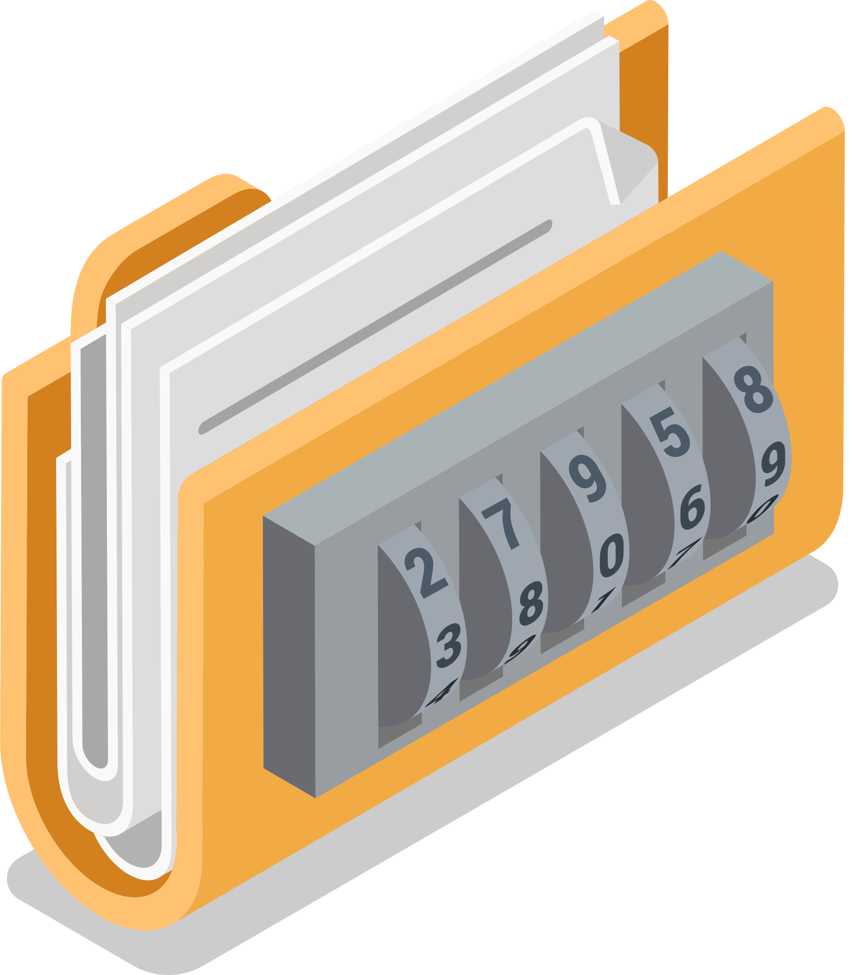
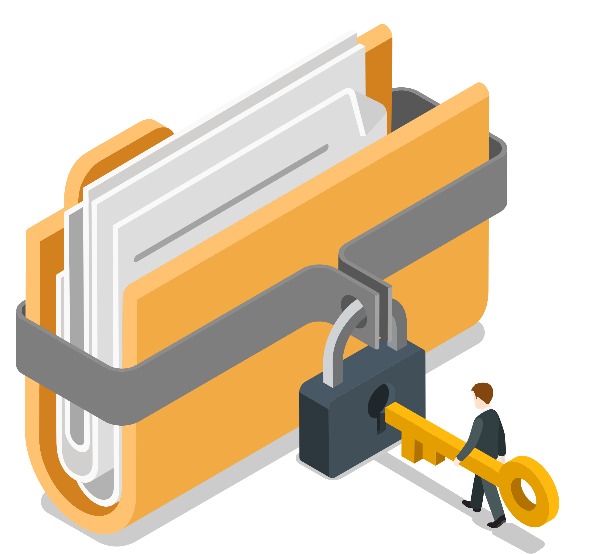
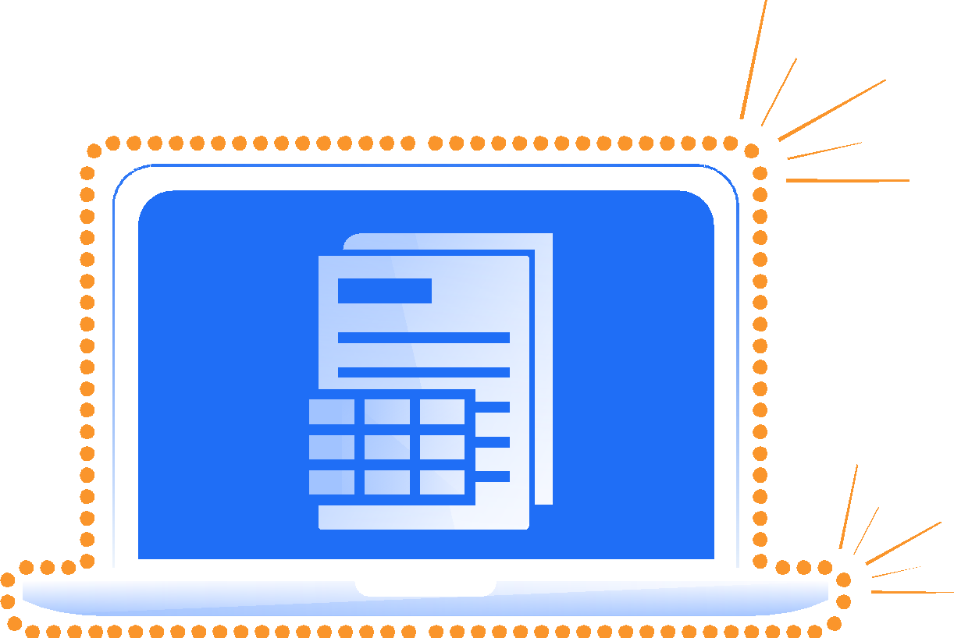
Think Shield Data Defense with AI Secured Storage
powered by Cigent®
A new approach to PRTECT endpoint data
Undetectable drives hides data
Zero-trust access control limits exposure
Secure Vaults render data completely invisible to malware, unauthorized users, and alternate operating systems
Hidden, encrypted partitions for the most sensitive content
Protected data cannot be cloned or “wiped”
AI Threat Protection stops ransomware execution
Trust, but verified, policy-driven MFA file and folder access control
Always-on or risk-based policy enforcement
Integrations with all major authentication solutions
“Shields Up” instantly prevents ransomware accessing protected data
Users remain productive during threats, no need to isolate or disconnect
Automation and integration with EDR, SIEM, and SOC solutions

