Slide 1
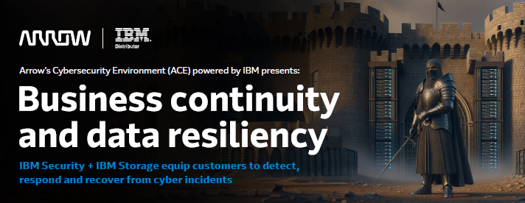
IBM Storage equips customers to detect, respond and recover from cyber incidents
Tony Owens: toowens@arrow.com Frank Welder: frank.welder@arrow.com
Brett Kerns: bkerns@us.ibm.com

Slide 2
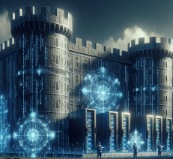
Our security team covers that
We have had a breach that got past our defenses,
What do we do now?
The threat came from inside our environment.
What happens when “S*IT Happens”?
Marriage Counseling

Slide 3
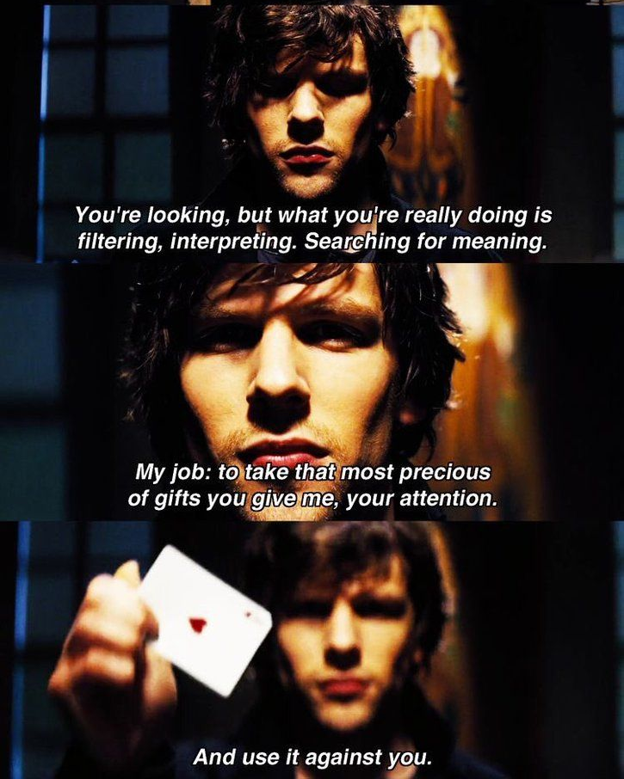
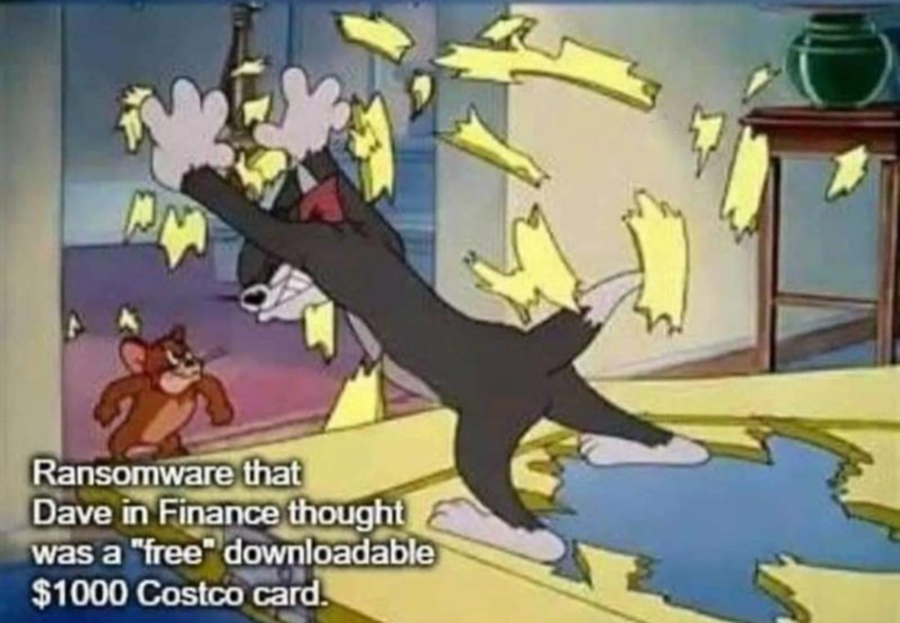
The Magic of a Hacker
Quote from Movie: Now You See Me
“Let me warn you. I want you to follow, because no matter what you think you might know, we will always be one step, three steps- seven steps ahead of you, and just when you think you're catching up, that's when we'll be right behind you. And at no time will you be anywhere other than exactly where I want you to be. So come close, get all over me because the closer you think you are, the less you'll actually see.”

Slide 4
Cybercriminal Playbook

Slide 5
WHAT DOES A CYBER ATTACK LOOK LIKE ?….
EXFILTRATE
READ
ENCRYPT
DELETE
READ
ENCRYPT
OVERWRITE
File
File
File
LOCKED
File
File
File
LOCKED
File
OPEN
OPEN
OPEN
OPEN
OPEN
OPEN
OPEN
READ
READ
WRITE
DELETE
READ
WRITE
READ
ENCRYPT
ENCRYPT
DELETE
CLOSE
CLOSE
CLOSE
CLOSE
CLOSE
WRITE
ENCRYPT
CLOSE
CLOSE
… A UNIQUE “FINGERPRINT”

Slide 6
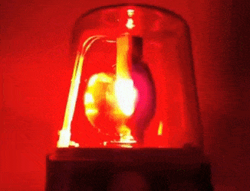
Data Resilience Why Act Now?
2X
Cyber Attacks YTY 2023 vs 2022, 2024 YTY 2.5x so far!
49%
of Cyber Attacks are ransomware (24%) or destructive (25%)
23
days, average recovery after a ransomware attack
26%
clients who paid the ransom still could not recover the data
66%
of breaches were not identified by the organization's internal security teams and tools
108
days faster identification and containment of a breach with extensive security AI & automation

Slide 7
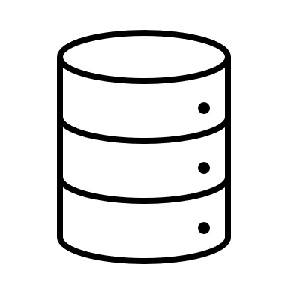
Rapid discovery and recovery
Accelerated Discovery
Malware scanning
Data pattern insights
Ecosystem scanner support
Secure Copies
Incorruptible
Layers of protection
Clean and reliable data copies
Automation
Simplicity
Rapid recovery
Primary and secondary workloads
Minimum viable company recovery in hours
Full company workload recovery in days

Slide 8
What challenges does IBM address? Need for integrated data security and protection
Data security helps detect and prevent attacks, but nothing to recover
Data protection is primarily reactionary and does not help avoid attack
Together, data security and data protection fulfill the NIST framework = Data resiliency
Data Protection
Data Security
Identify
Data Security
Data Protection
Data Protection
NIST & Governance
Protect
Recover
Data Security
Data Security
Data Protection
Respond
Detect
Data Protection

Slide 9
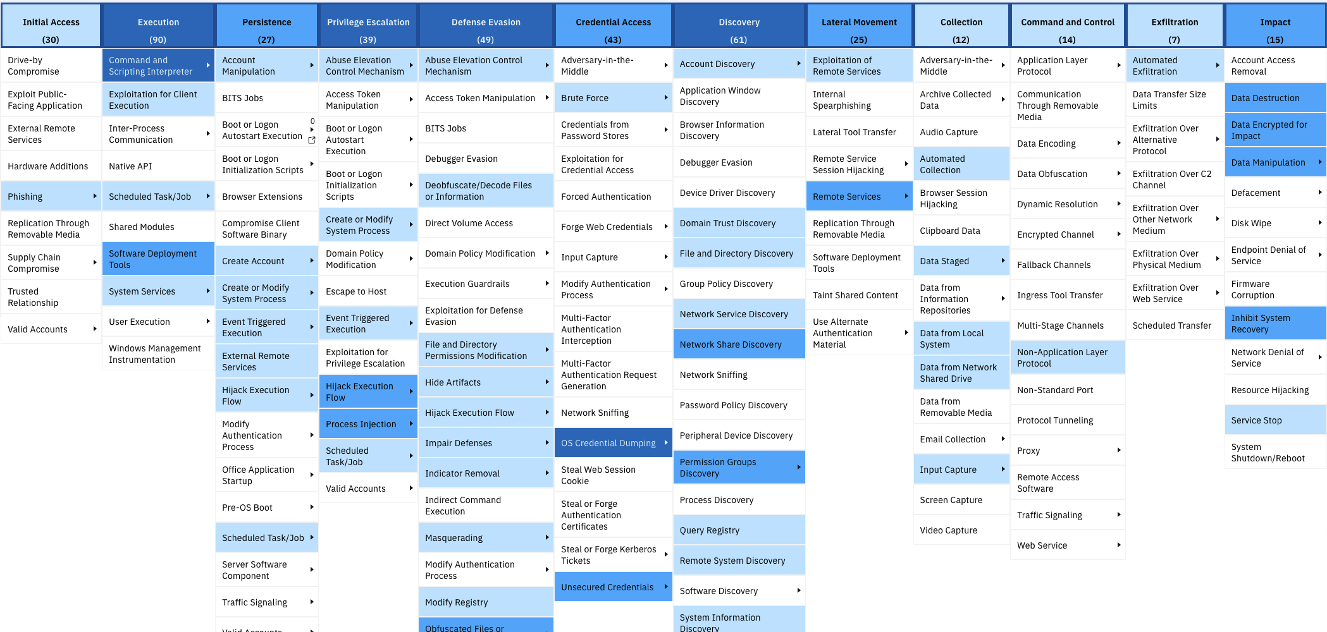
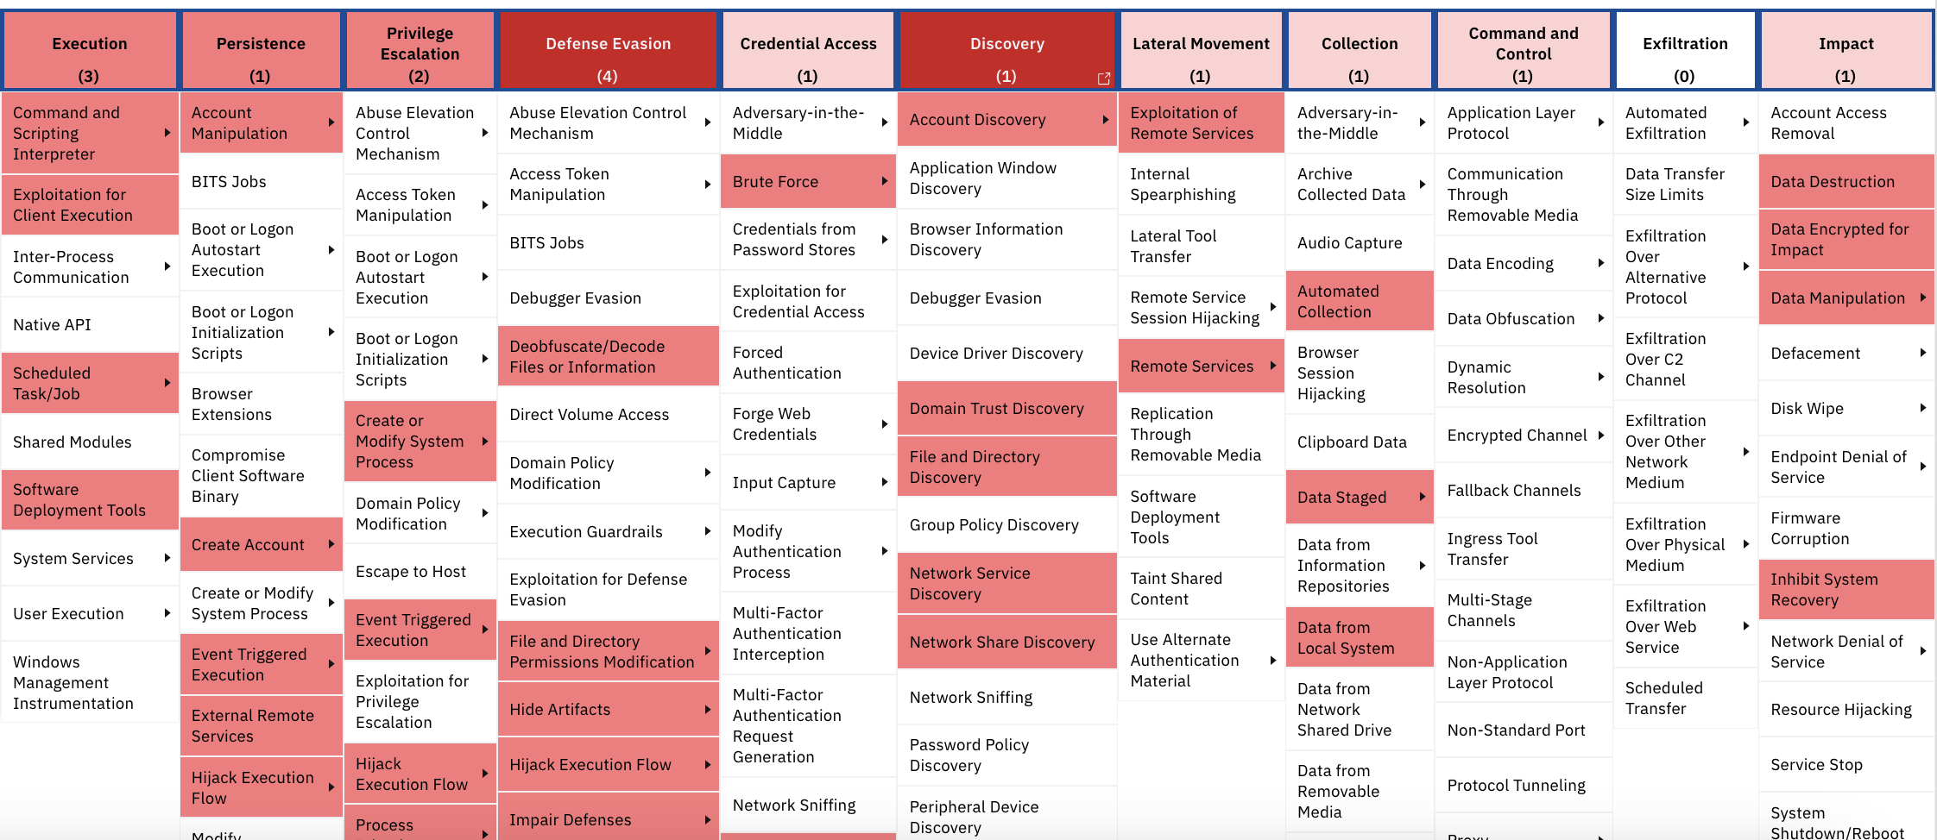
Castle Walls (MITRE ATT&ck Framework)

Slide 10
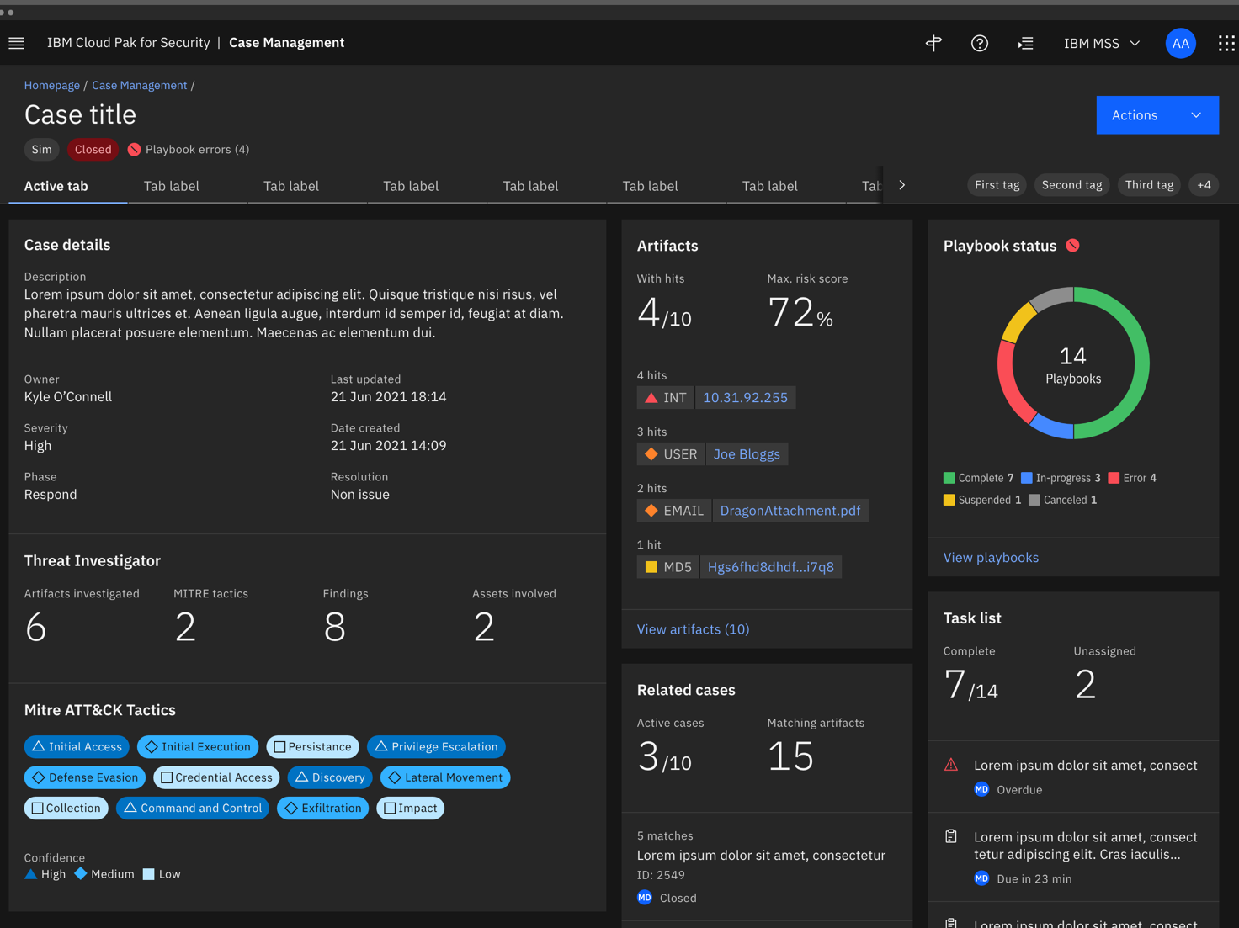
IBM’s Modern Case Management / SOAR Experience: End-to-End Capability
Identify in a single pane the who, what, how, and actions taken on a security investigation and incident response
Details Tasks Breach Notes Members Attachments Artifacts
What happened and how severe is this?
What are the highest priority artifacts involved?
What’s already been done, and what should I do next?
What MITRE TTPs were used?

Slide 11
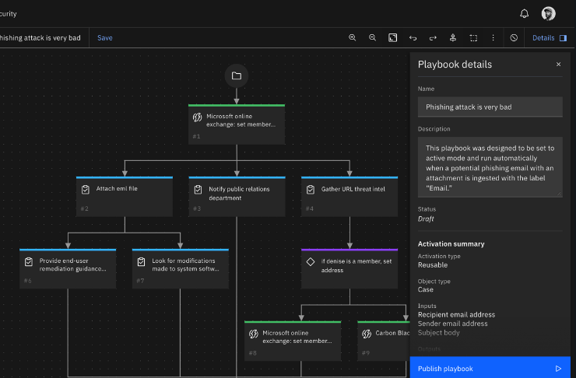
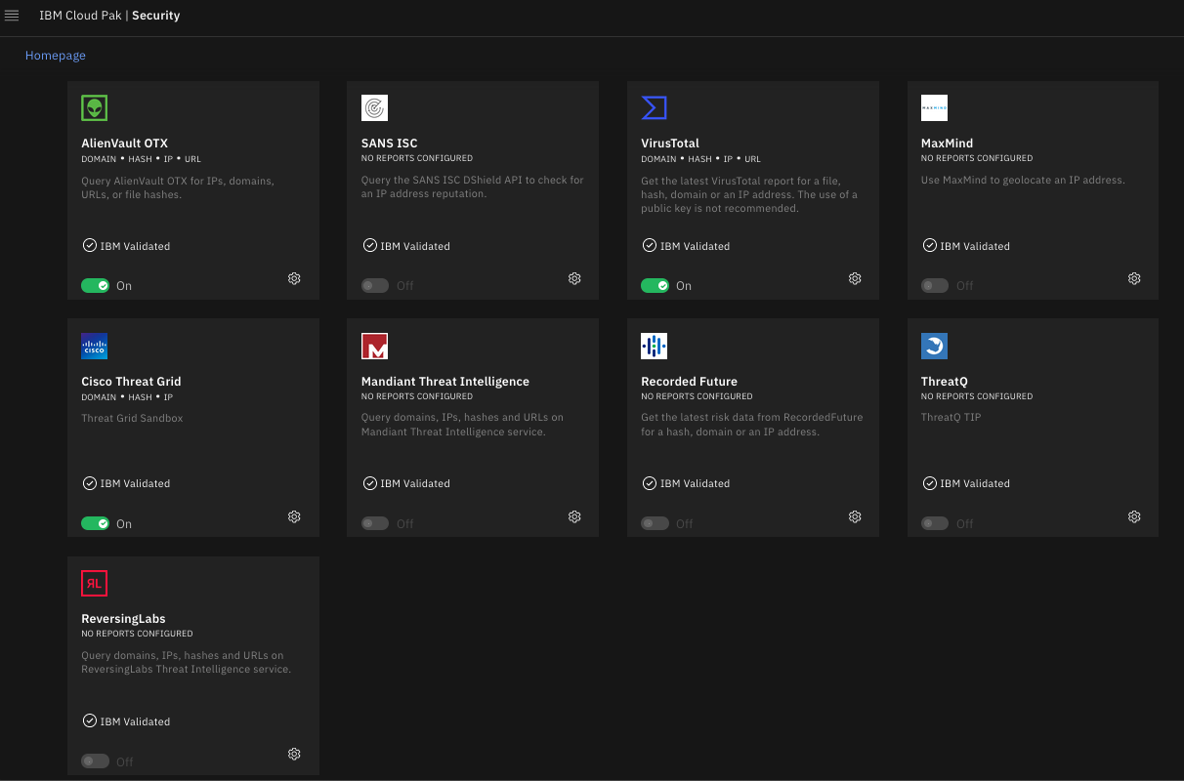
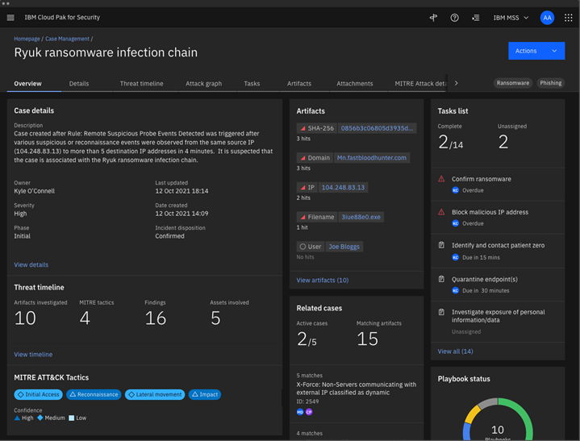
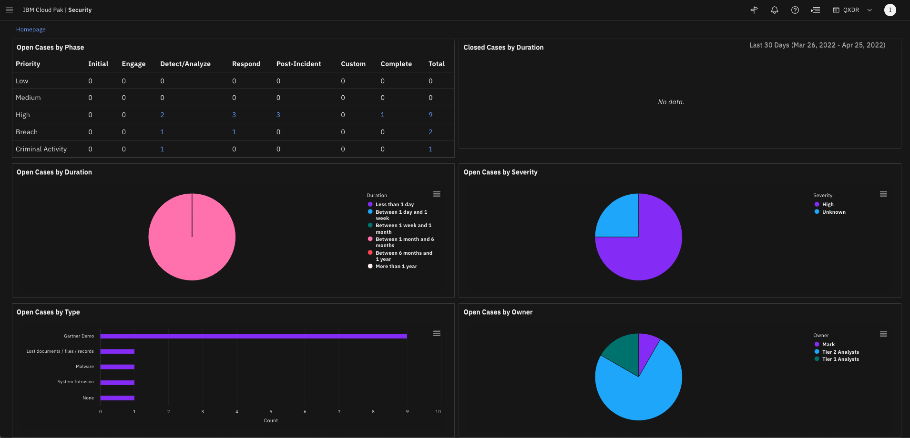
Streamline response with automation and intelligence
Respond x7 faster with dynamic playbooks that combine people, process and technology
QRadar SOAR in action
Quickly and easily create playbooks with OOTB content and 100's of available integrations
Adapt and respond more quickly with dynamic playbooks
Leverage Threat Intelligence feeds to automatically enrich and action Indicators of Compromise
Seamlessly integrated analyst workflow speeding up investigations and response
Assess and report on SOC performance with available reporting templates and customized dashboards

Slide 12
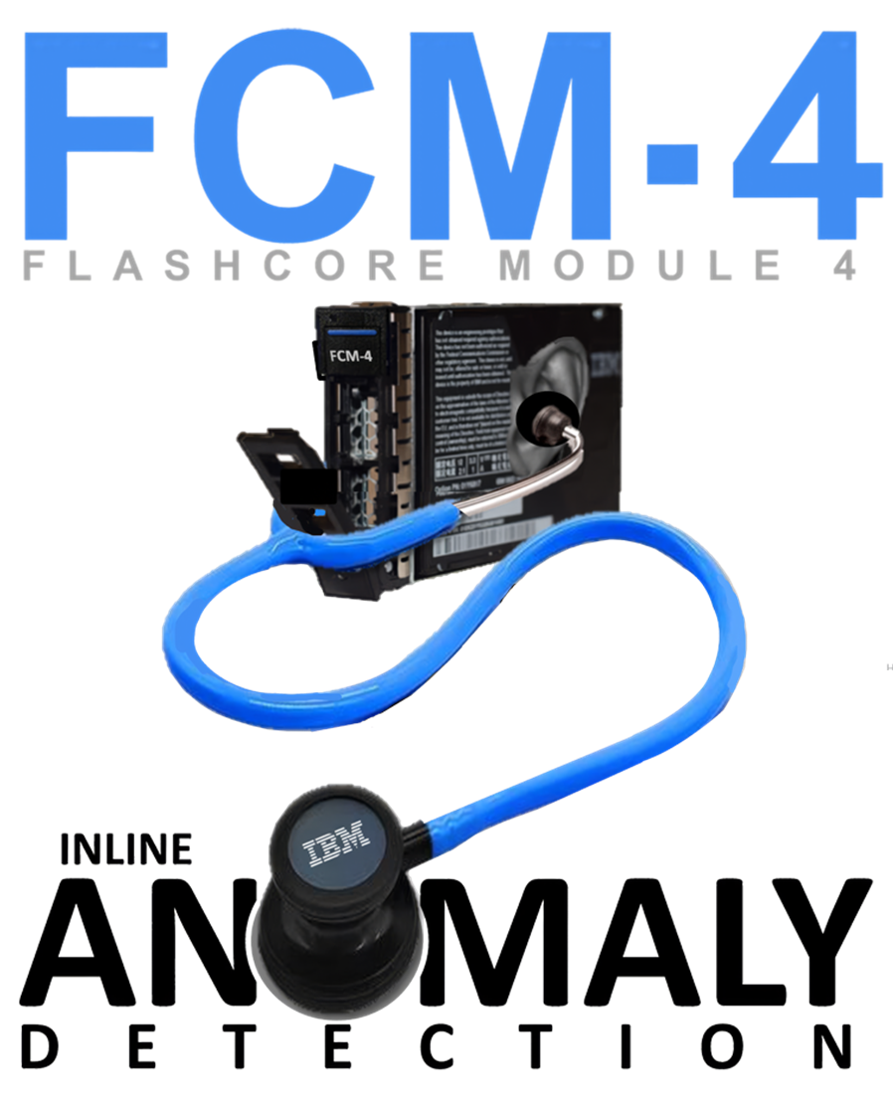
A Breakthrough in Cyber Security
Secure & Resilient
Data Encryption/Destruction over time
24 Hours
2.5PB data
Capacity
Recovery speed AND amount of data to recovered are crucial to business recovery
2.5PB
1.25PB
1TB
Time (hrs)
What if you knew the problem here?
Discover in <1 min, only 1.7TB impacted

Slide 13
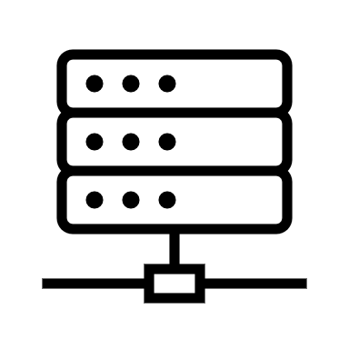
The CORE of IBM’s FlashSystem Cyber Resiliency is STORAGE VIRTUALIZE
STORAGE INSIGHTS WATSONX DATA LAKE
STORAGE VIRTUALIZE TELEMETRY DATA
Hosts access
Storage Virtualize
SAFEGUARDED COPY
SCHEDULER
RANSOMWARE THREAT DETECTION (RTD)
STORAGE VIRTUALIZE “OPERATIONALY FREE”
SIEM / SOAR
Integration
STORAGE VIRTUALIZE
SV
Inference
Engine
Telemetry Data
Inference engine
Storage Virtualize
Access Storage
Extents
Internal or External
Primary MVC pool
SAFEGUARDED COPIES
SGC (hidden)

Slide 14
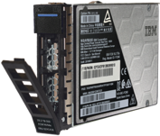
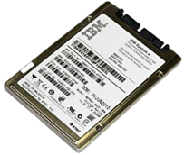
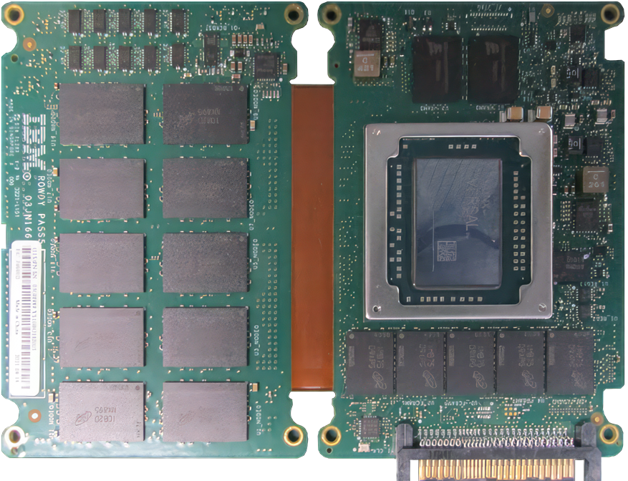
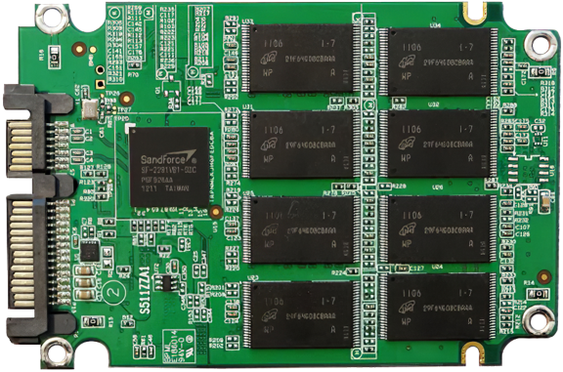
IBM INNOVATION DELIVERS MORE CAPABILITY
NVMe FCM vs NVMe SSD
Industry Standard 2.5” form factor
*** Some vendors create non-standard devices
ABILITIES | FCM | SSD
Zero-impact Quantum safe encryption | ✓ | ✘
Zero-impact Realtime Ransomware Threat Detection (RTD) | ✓ | ✘
Zero-impact data compression and compaction (3:1 Guarantee)* | ✓ | ✘
Variable Stripe RAID (VSR) | ✓ | ✘
176-layer QLC with ultra-low latency | ✓ | ✘
In-module data tiering MRAM/DRAM/SLC/QLC | ✓ | ✘
AI driven health binning enables QLC > durability than TLC | ✓ | ✘
Unparalleled density in a 2.5” industry standard form factor (FF) | ✓ | ✘
Magnetoresistive Random
Access Memory (MRAM)
PROCESSOR
ARM / FPGA
FLASH
Capacitors for Power Loss
FLASH
DRAM
CONTROLLER
LOGIC
U.2 Connector
Extreme density in a 2.5” Form Factor (FF)
Greater density & small FF = sustainability
**4.8TB (22TBe)
Native 5:1 compressed
9.6TB (29TBe)
Native 3:1 compressed
19.2TB (58TBe)
Native 3:1 compressed
38.4TB (115TBe)
Native 3:1 compressed

Slide 15
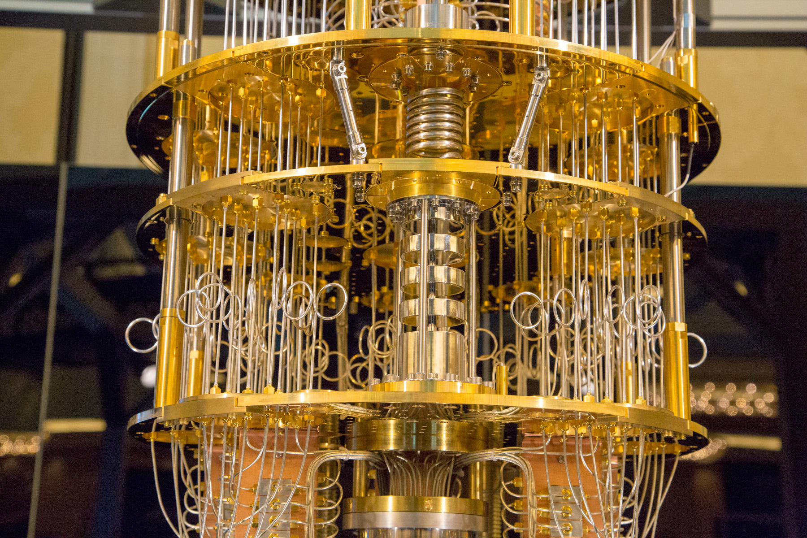
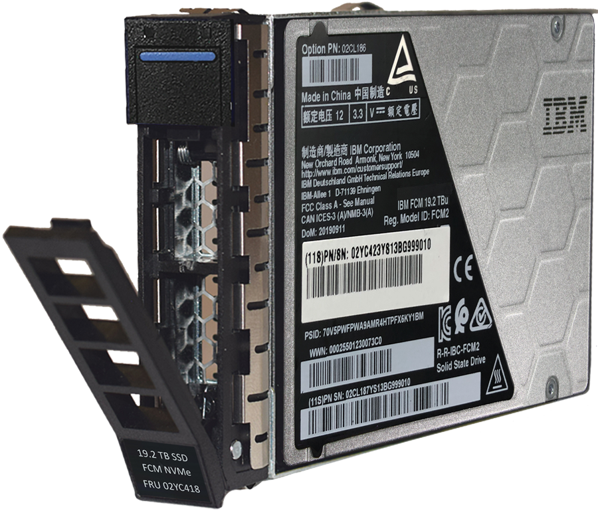
IBM FLASHCORE MODULE 4– QUANTUM SAFE ENCRYPTION
IBM FCM4 EQUIPPED WITH:
Quantum Safe Cryptography (QSC)
Asymmetrical Cryptographic Algorithms
CRYSTALS-Dilithium signatures for authentication and FW verification
CRYSTALS-Kyber for secure key transport of unlock PIN transmitted by IBM FLASHSYSTEMS Controllers to FCM’s
Customer data encrypted in flash memory with *XTS-AES-256
Magnetoresistive Random
Access Memory (MRAM)
Capacitors for Power Loss
PROCESSOR
ARM / FPGA
FLASH
DRAM
U.2 Connector
* A Quantum computer capable of breaking AES-256 encryption with any known algorithm today, is likely decades away…

Slide 16
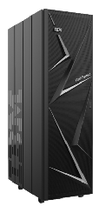
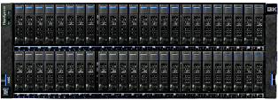
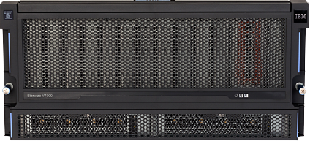
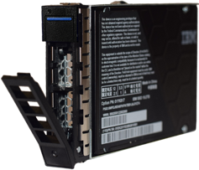
IBM FLASHSYSTEMS HARDWARE Purpose-built hardware, Storage Virtualize & Storage Insights across the entire product family providing integrated AI driven cyber resilience without comprising performance
FLASHSYSTEM 5015
IBM Storage Virtualize
for Public Cloud
SAS HDD / SDD
FLASHSYSTEM 5045
FLASHSYSTEM 7300
FLASHSYSTEM 9500/R
FLASHSYSTEM 5300
SAN Volume
Controller SV3
NVMe / FCM / SCM
NVMe / FCM / SCM
NVMe / FCM / SCM
External Virtualization
New
ADDITIONAL CONSUMPTION
MODELS
Storage Assurance (NEW)
Storage Utility Option (SUO)
Storage as a Service (StaaS)
New
HDD & SAS EXPANSION UNITS
5U92 SFF & LFF
2U12 LFF
2U24 SFF
IBM STORAGE INSIGHTS = Generative AI with RTD, full fabric monitoring, full stack visibility, predictive support
IBM STORAGE VIRTUALIZE = Storage function, scalability, interoperability, cloud integration and automation

Slide 17
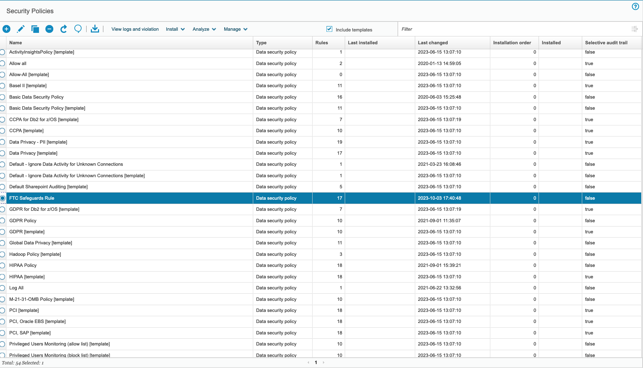
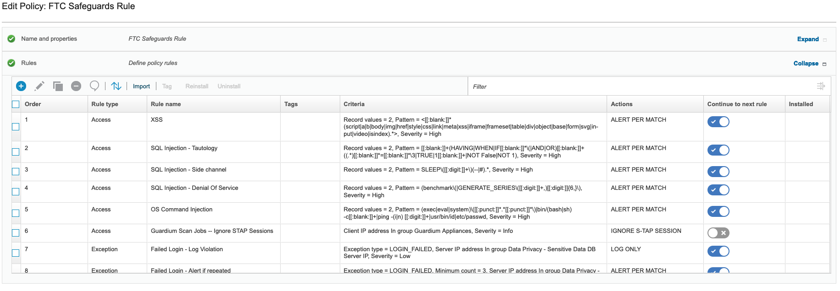
Data Governance Lifecycle – Governance - Policy
Governance
Policy
Classify
Catalog
Resilience

Slide 18
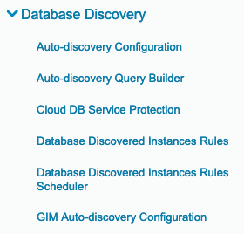
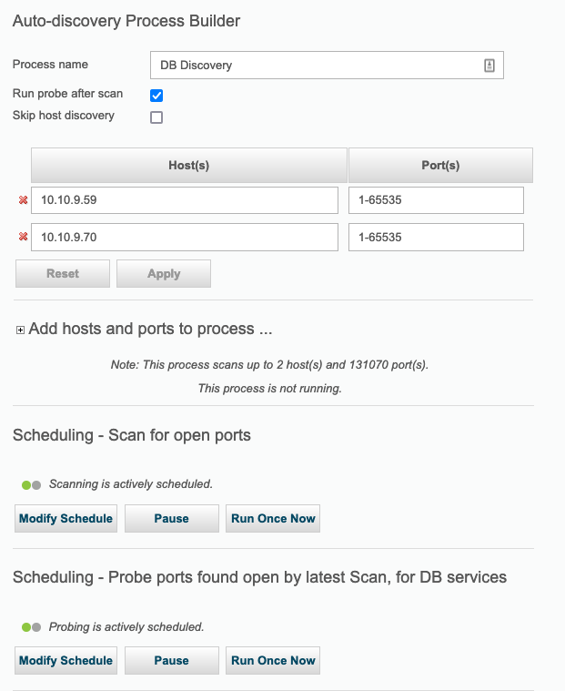
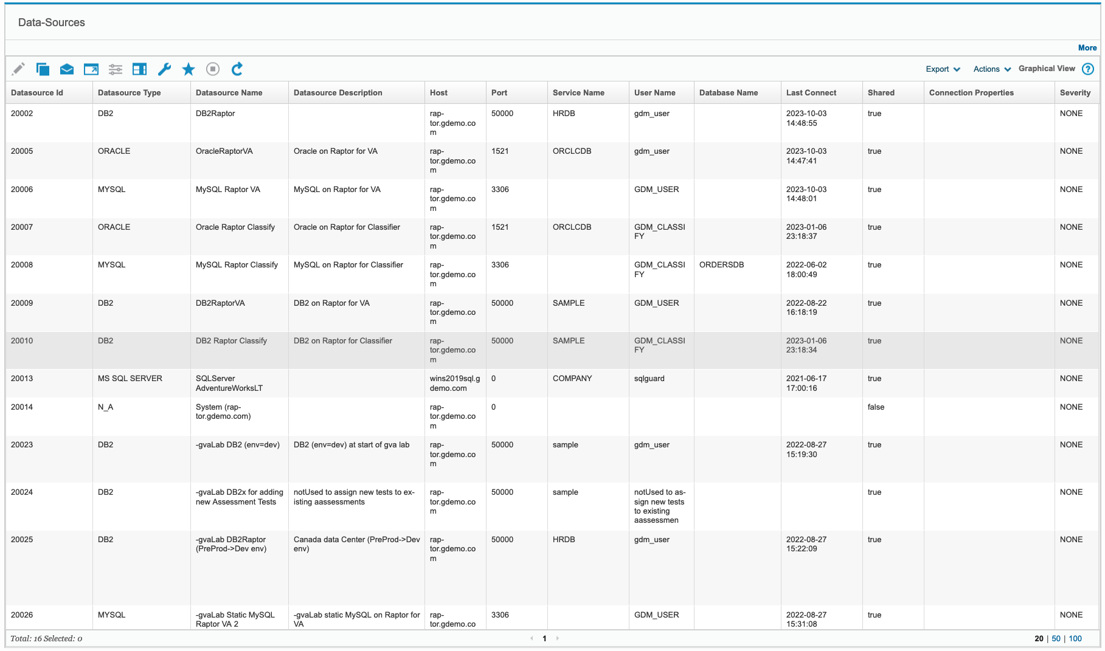
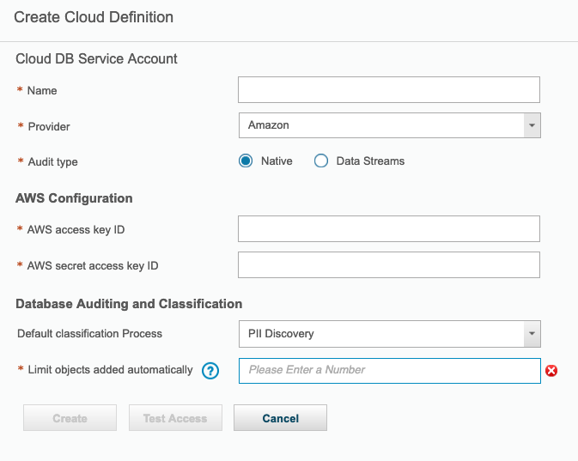
Data Governance Lifecycle – Discovery - Databases
Discovery
DB's
Files
Network

Slide 19
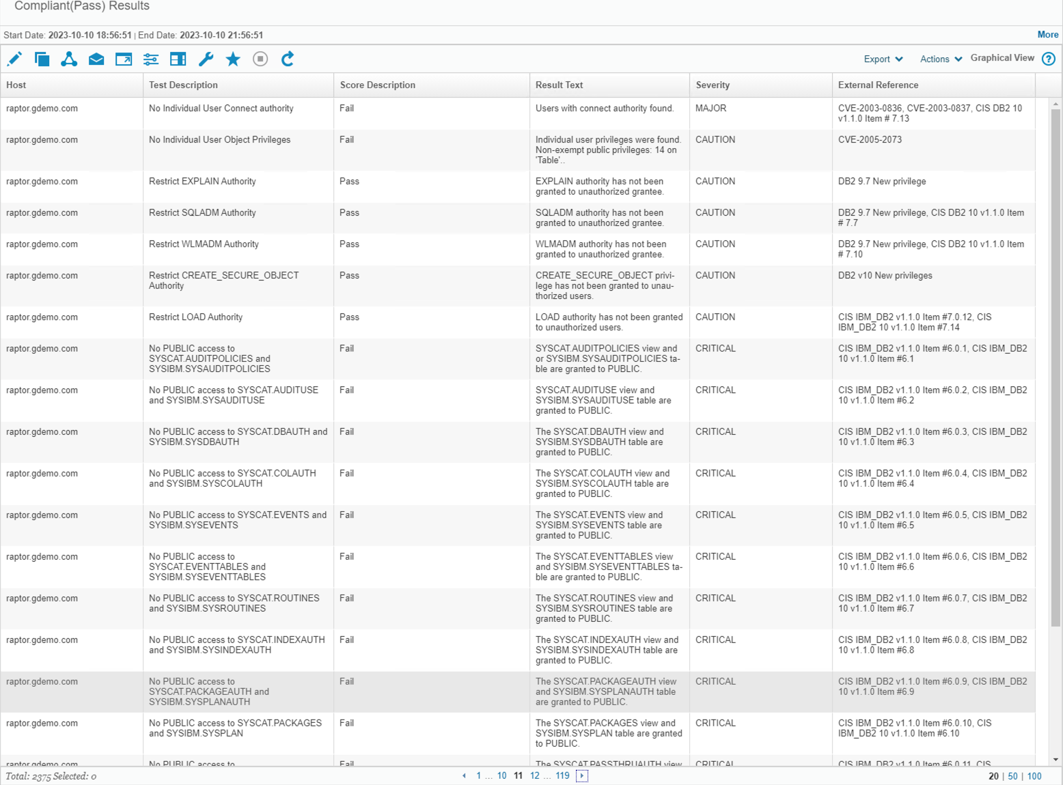
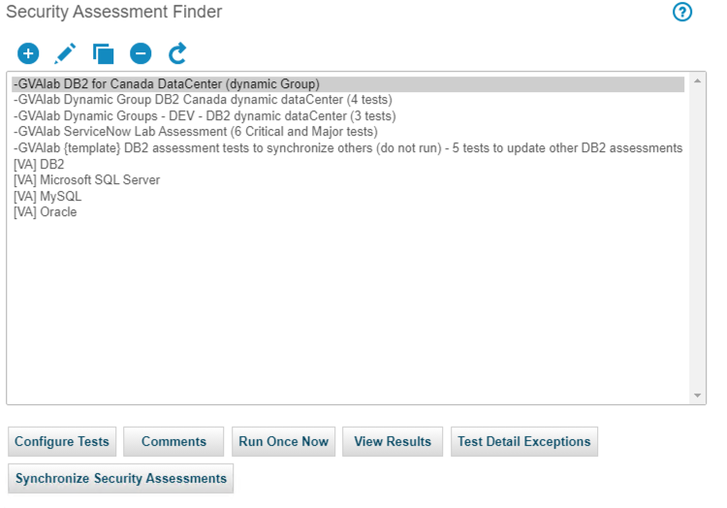
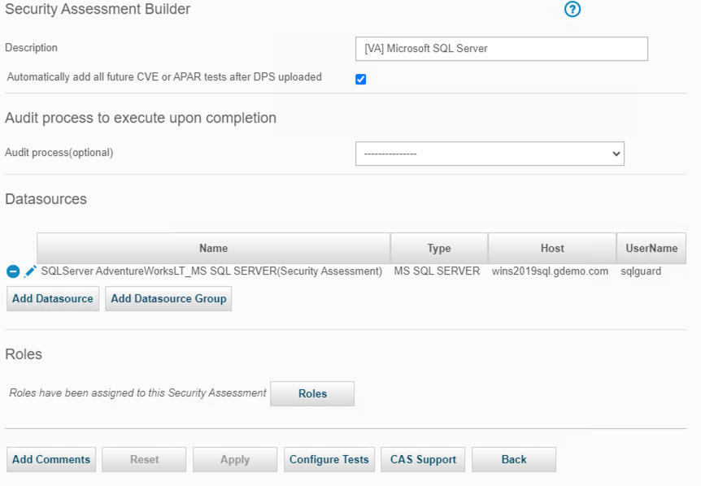
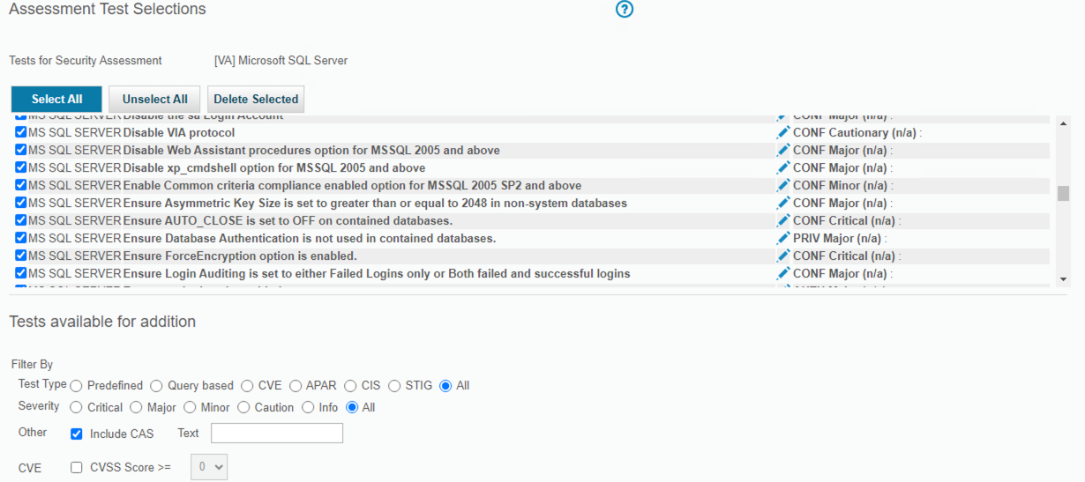
Data Governance Lifecycle – Protect
Protect
Encrypt/Key Mgt
Access Control
Harden
Backup/SafeGuard CP

Slide 20
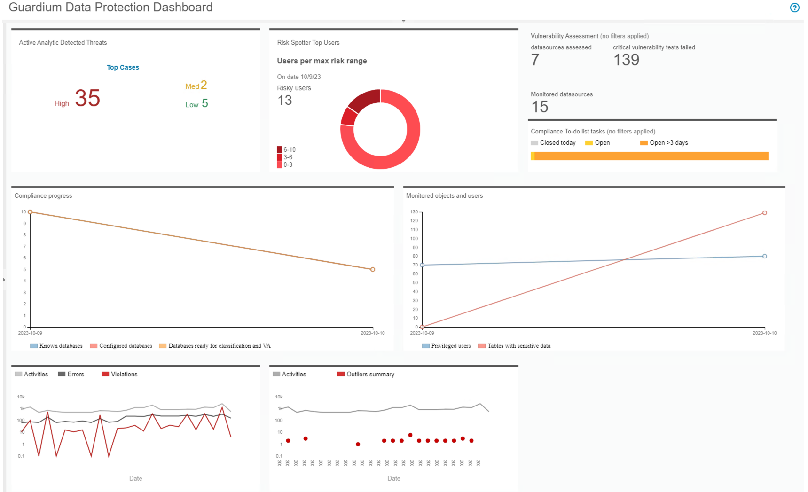
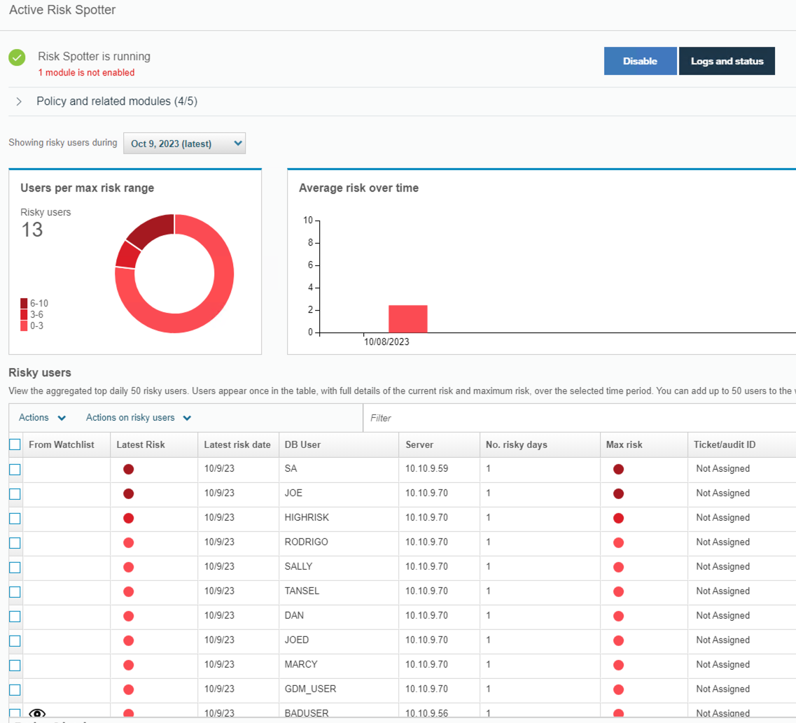
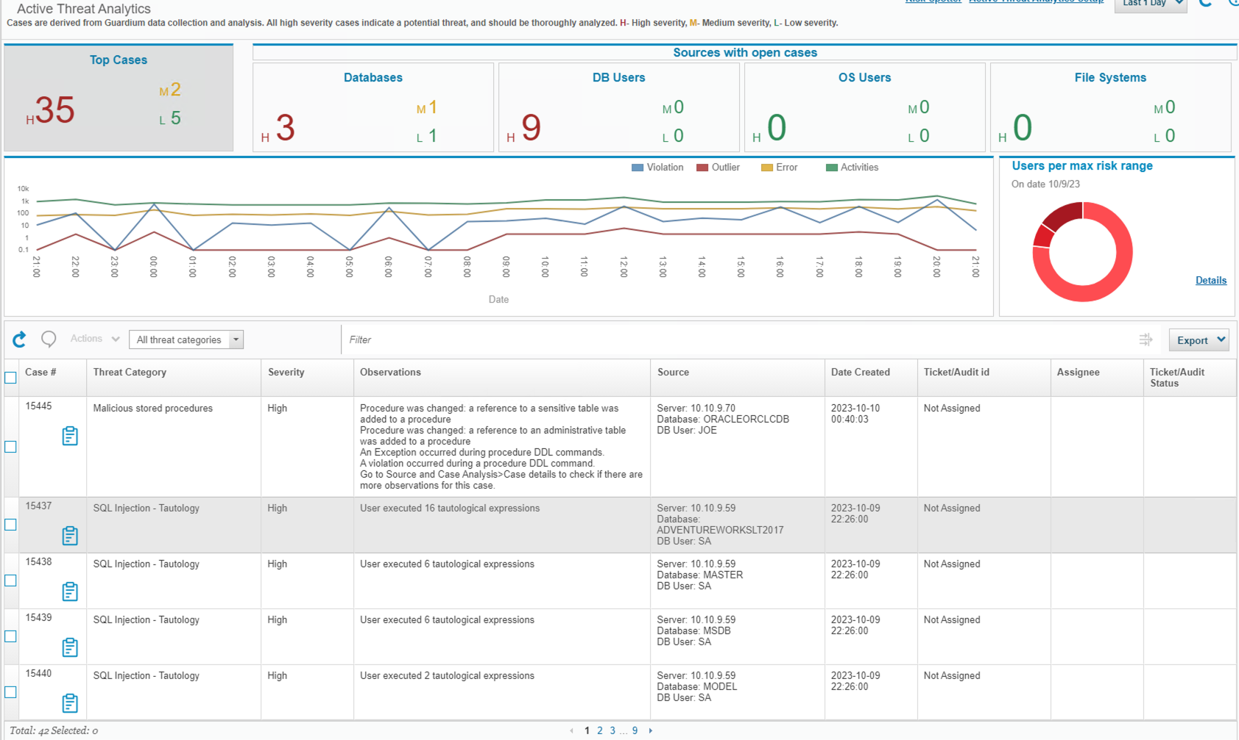
Data Governance Lifecycle – Detect
Detect
Monitor
UBA
Analytics
Alerts

Slide 21
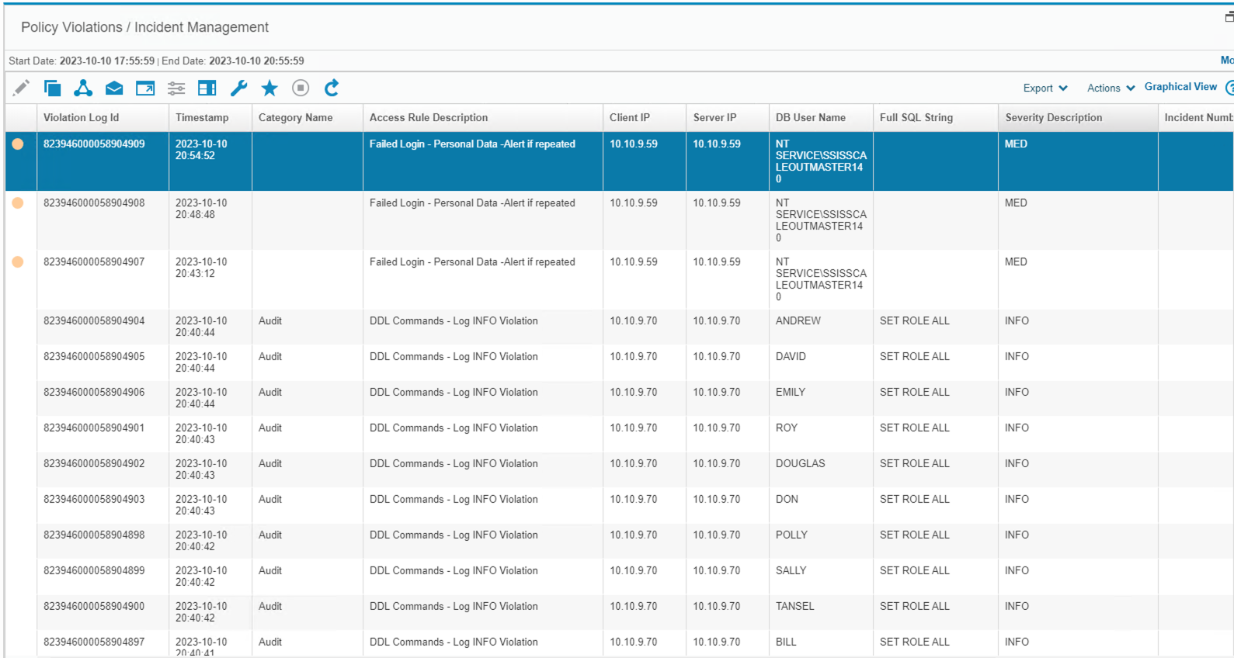
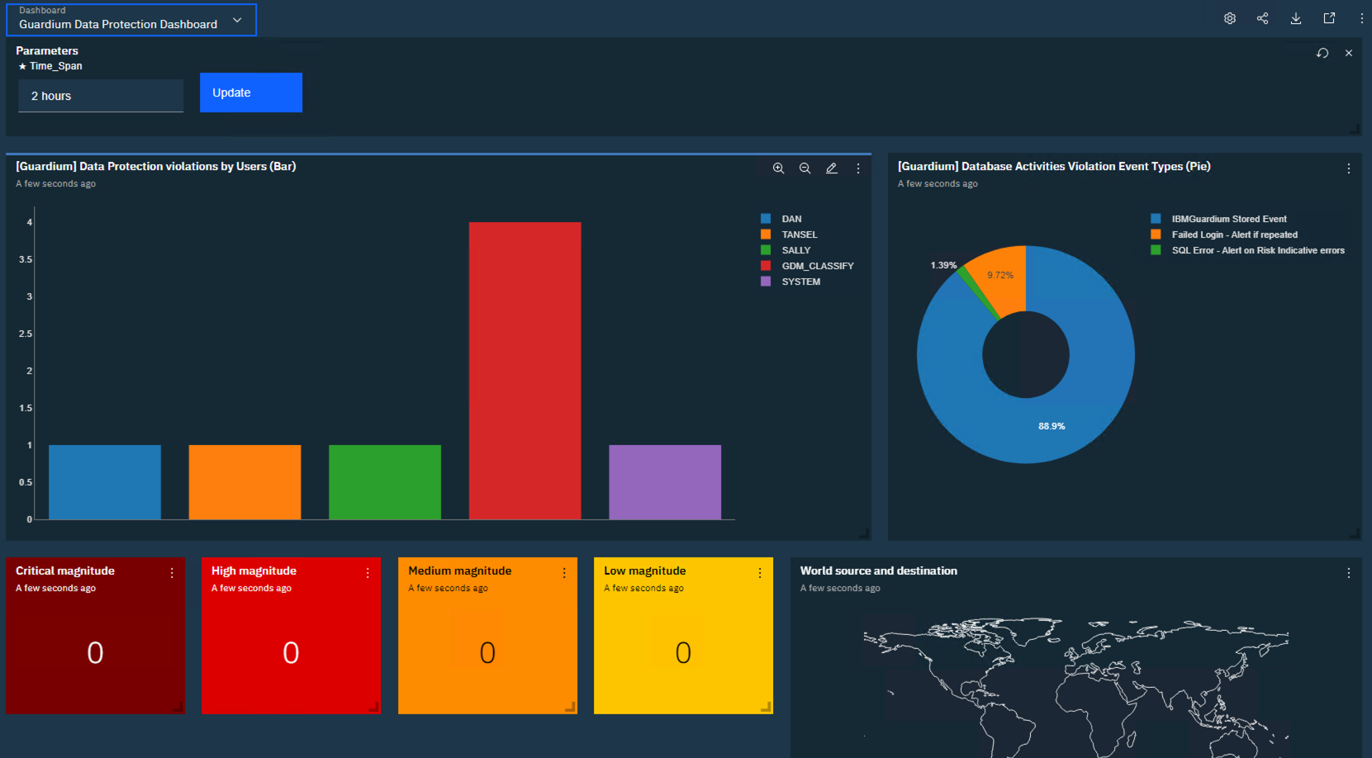
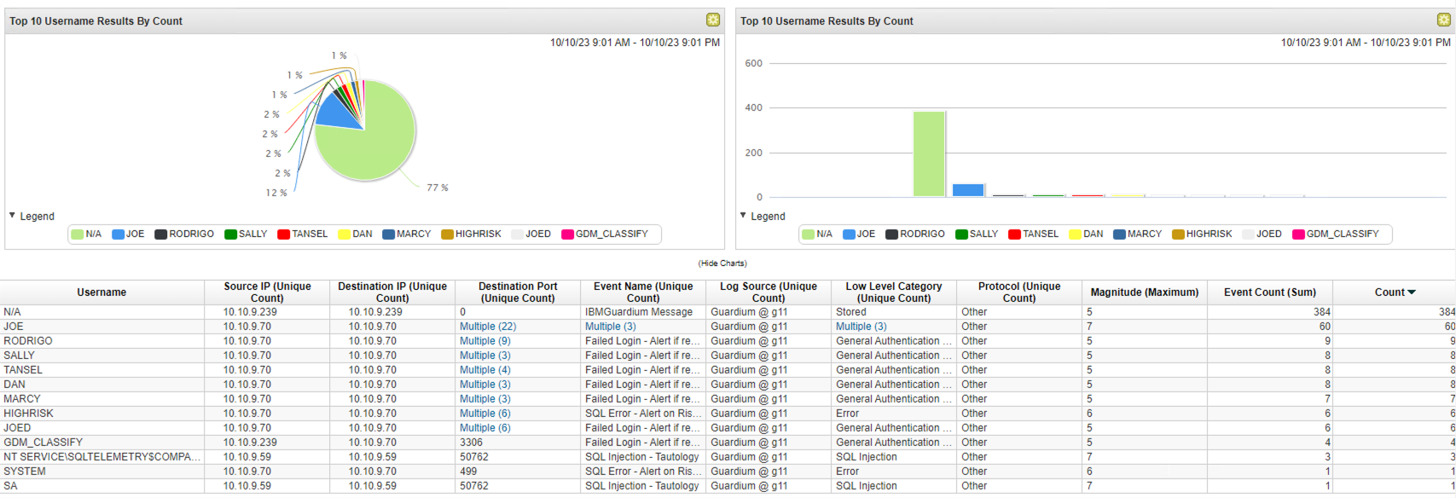
Data Governance Lifecycle – Detect
Detect
Monitor
UBA
Analytics
Alerts

Slide 22
Steps to Data Resilience
recovery
discovery
04
03
Rapid operational recovery in seconds, minutes, hours
Avoid paying ransoms
Find active threats
Find & prevent dormant threats
automation
IMMUTABILITY
05
02
Simplified operations plus ability to test and prove recoverability
Integration between Cyber Security & Cyber Resiliency
Recoverable data points
Incorruptible, data can not be deleted
SECURITY & Data protection
01
Predict, prevent, and respond SOC Integration
Protect from infrastructure failures and Natural disasters

Slide 23
Steps to Data Resilience
Min Viable Company
Fastest recovery, short term retention, on-array
Data Integrity
Machine learning, malware scanning, testing
04
03
Full company
Lower cost, long term retention, off-array
Anomaly Detection
Machine learning minimize false positives
Orchestration
Simplicity, integration with SIEM/SOAR
Data Isolation
Physical, logical
05
02
Data Protection
Data copies
Holistic visibility, coordinated response, proactive planning
integration with existing infrastructure, backup and security
IBM Storage
01
Defender
Data Classification
Compliance, risk,
Business impact
Cyber Security
SOC Integration

Slide 24
Production
Workloads
Secure Immutable copies
Discovery scanning & Clean Room
Clean Room
Deep Scan
10010110
10010110
10010110
10010110
10010110
11100001
11100001
11100001
11100001
11100001
10000001
10000001
10000001
10000001
10000001
6:00
9:00
12:00
15:00
18:00
Disruption minimised
Rapid Recovery
Backup
With IBM
Data Resilience
Minimum Viable Company
Inline Data Corruption detection
SOAR
SOAR Playbook
Request Action
Isolate Workload
Metadata
Machine Learning
Corruption detection
Recover Clean Copy

Slide 25
Prevent & Minimize Operational Impacts
1 day
2 days
RECOVER
3 days
10 Hours
Minimized
respond
1 week
Hours
Automation
DETECT
Minutes
2 weeks
Active threats
Seconds
Attack
Zero
23 Days
prevention
Detect dormant threats BEFORE they become active

Slide 26
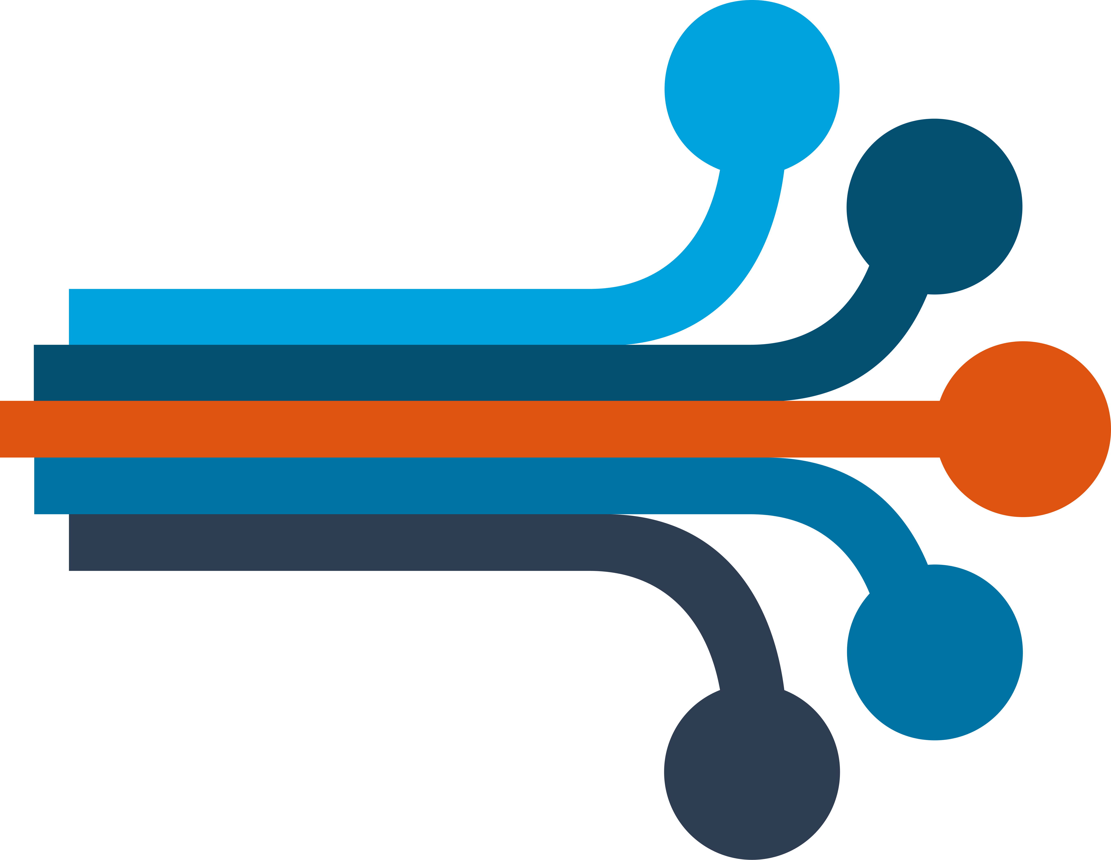
Secure our Castle and the Data within…
Defender
Automation
Rapid Recovery
IBM Security
Discover Threats
Secure Immutable Copies
Cyber Security Integration
IBM Storage FlashSystem
Safeguarded Copy
and Inline Data Corruption Detection

Slide 27
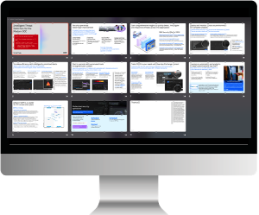
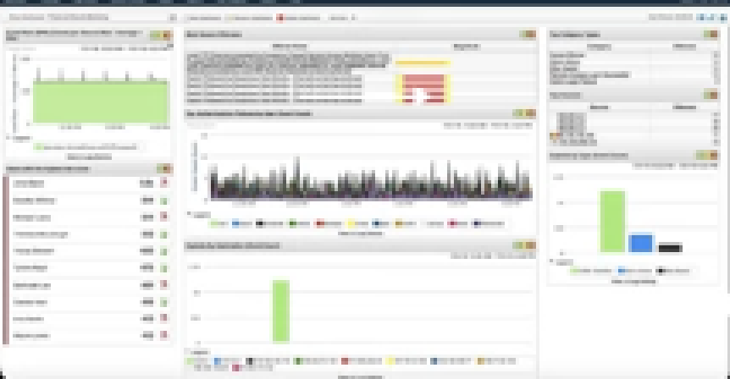
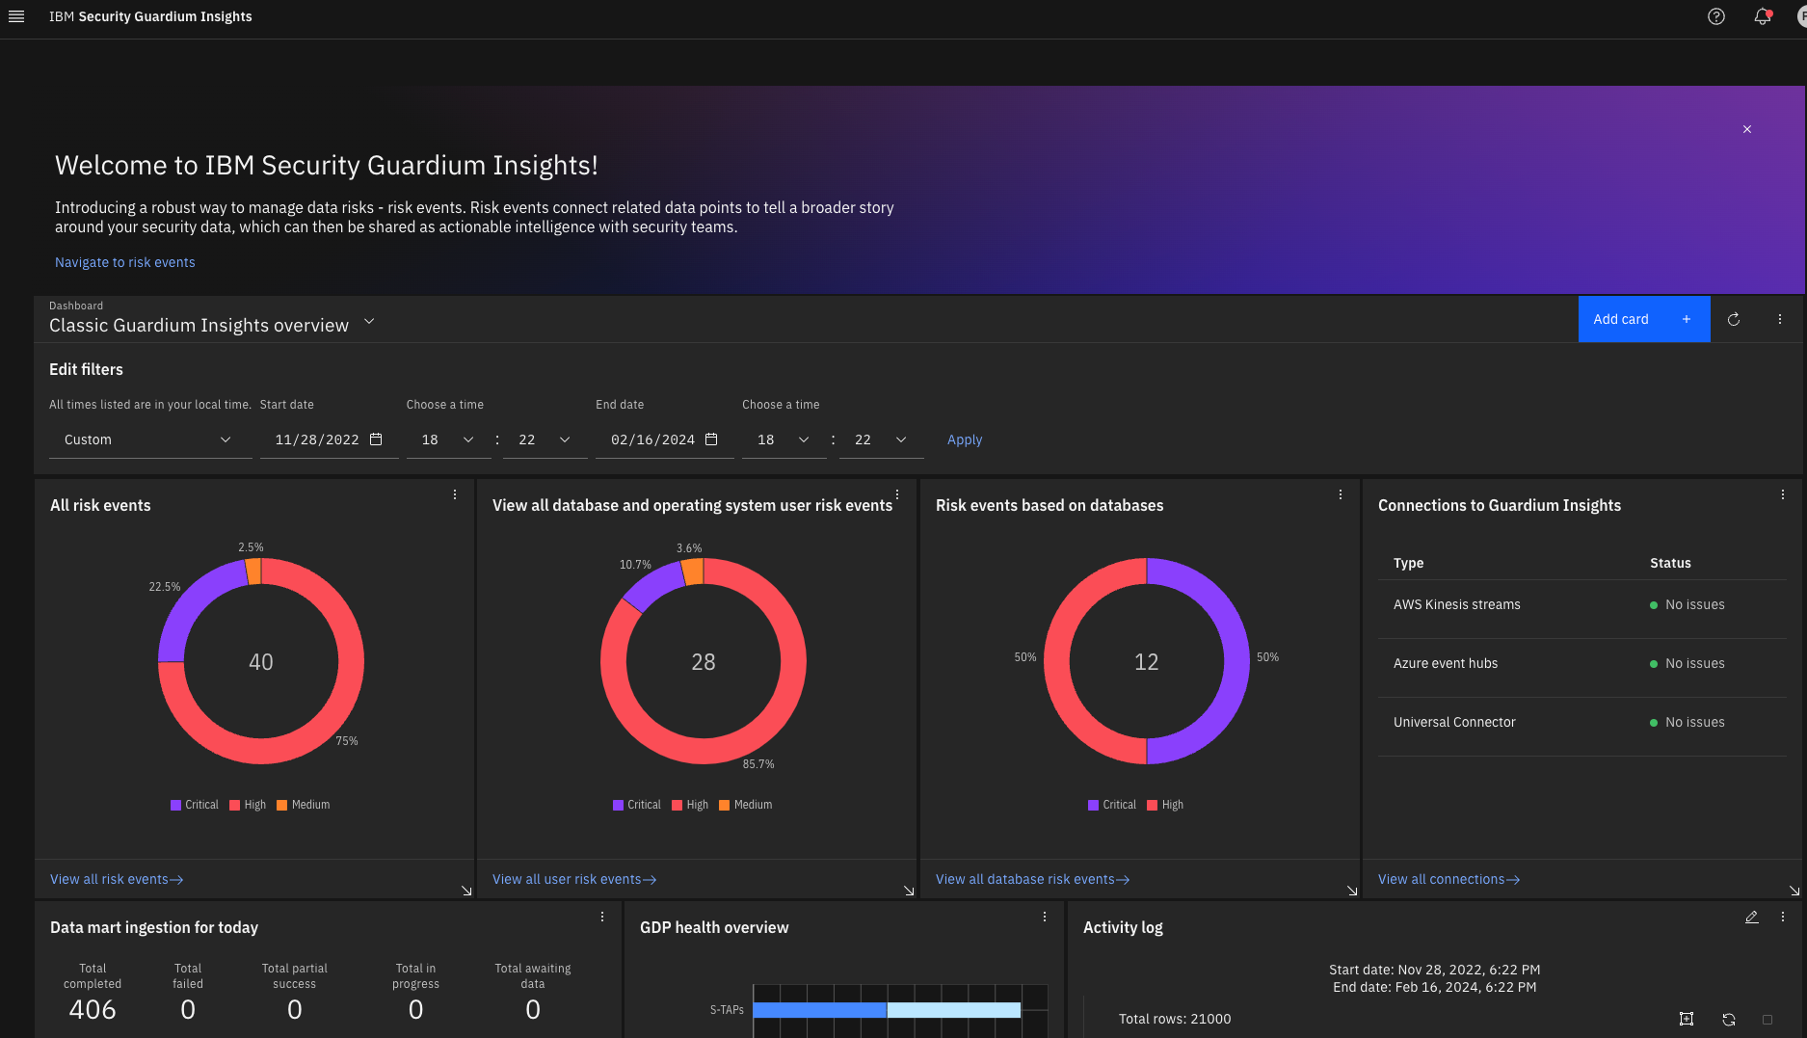
IBM PROVIDES SECURE AND RESILIENT INFRASTRUCTURE
Notification of Anomaly detected
Protect data in cloud environments
IBM Security Verify Governance
Provision, audit and report on user access and activity through lifecycle, compliance and analytics
QRadar Log Insights
Invoke Safeguarded Copy if threat is detected
IBM
SIEM correlates Guardium events and invokes blocking/quarantine of compromised DB users/connections
QRadar EDR
IBM Security Guardium
Identify data security
and compliance risks
QRadar SOAR
Protect data on-premises environments
QRadar SIEM
Ransomware Threat Detection anomalies sent to IBM via Storage Insights
Data Security threat cases and alerts sent to SIEM for correlation; SOAR for playbook / incident response
IBM Security Qradar Suite
Modernized threat detection and response
Guardium Key Lifecycle Manager
Centralizes, simplifies and automates key management process
AUDIT LOGS
Fiber channel Switch Network
IBM FlashSystem

Slide 28
CUSTOMER ASSESSMENT IS THE DESIGN STARTING LINE
Asset Management
Business Environment
Governance
Risk Assessment
Risk Management Strategy
AN SRA IDENTIFIES & HELPS PREPARE
Recovery Planning
Improvements
Communications
RECOVER
SYSTEM RESILIENCY ASESSMENT SIGN UP NOW
Free lightweight self assessment, 2-hour survey
TIME TO COMPLETE – 2 WEEKS
Broad scope security assessment
GOVERN
NIST
Cybersecurity
Framework
IDENTIFY
RESPOND
PROTECT
CYBER INCIDENT RESPONSE ASSESSMENT (CIRSA)
Identify Disaster Recovery gaps
Minimize exposure and recovery time
TIME TO COMPLETE – 3 WEEKS
Deeper analysis that the CRAT
DETECT
Response Planning
Communications
Analysis
Mitigations
Improvements
Access Control
Awareness Training
Data Security
Information Protection
Protective Technology
CYBER VAULT ARCHITECTURE WORKSHOP (CV-AW)
Design workshop to facilitate Cyber Vault install
TIME TO COMPLETE – 2 WEEKS
Focused on Cyber Vault implementation
Anomalies and Events
Security and Continuous Monitoring
Detection Processes

Slide 29
THANK YOU

